Slide 1
Stress, Trauma, and Resilience: A Focus on the Workforce
Nima Sheth MD, MPH
Senior Medical Advisor, CMHS
Substance Abuse and Mental Health Services Administration
U.S. Department of Health and Human Services
CMHS
August 18th, 2021
Notes:
Presentation title slide
Do not change colors
Add title where designated

Slide 2
A Moment to Arrive…

Slide 3
Stress and Stress Response
An adaptive response to an environmental stimulus that enhances survival, development and function
Not just an emergency response but an ongoing process of adaptation
Mild stress improves performance=beneficial
Higher stress impedes performance
Severe stress can be toxic (can cause fear conditioning)
Good Stress~Bad Stress
Slide from Akil, 2021

Slide 4
We are all Fragile and Resilient
Slide from Akil, 2021

Slide 5
Stress Injury Basics

Slide 6
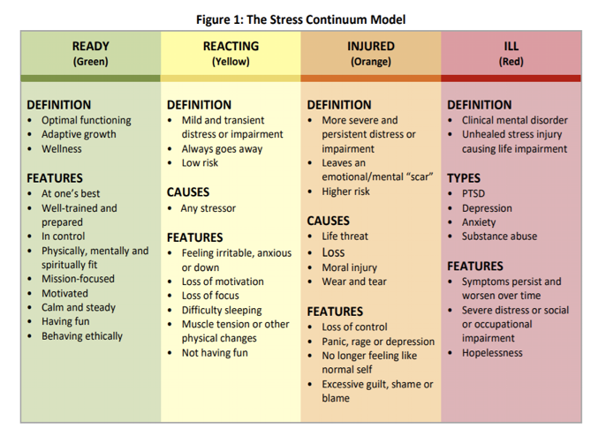
The Stress Continuum Model
Notes:
All notes taken from: https://www.ptsd.va.gov/professional/treat/type/stress_first_aid.asp
Stress Continuum Model
•The Stress Continuum Model forms the foundation for Stress First Aid. It also indicates that four possible types of stress “injury,” trauma, loss, inner conflict / moral injury, and long-term chronic stress, or “wear and tear,” might move a person from the Yellow Zone of stress the Orange or Red Zones.
•Stress responses lie along a spectrum of severity and type — from transient and mild to chronic and debilitating. The continuum has four zones: Ready (Green), Reacting (Yellow), Injured (Orange) and Ill (Red). It is important to note that 100% of people will react when faced with significantly stressful experiences. However, the way in which they respond will depend on many factors, including how prepared they are for the stressor and how they interpret it. A person’s reaction can range relatively rapidly from Green to Yellow to Orange to Red and back again.
•Stress First Aid was adapted from the Navy/Marine Corps Combat Operational Stress First Aid (COSFA). The Stress Continuum Model was developed as a visual tool for assessing an individual's stress responses and forms the foundation for both COSFA and SFA. It was also designed to reduce stigma by showing that people can go in and out of ranges of stress reactions frequently, based on a variety of factors.
•This Model acknowledges that within this range of reactions to stress, a person can go from being in optimal functioning---feeling good, mentally and physically fit, mission focused, calm, and motivated---into what's called the Yellow Zone. In the Yellow Zone a person can feel more irritable anxious or down, have a loss of motivation, loss of focus, have trouble sleeping, or have muscle tension or other physical changes, but these are transient reactions.
•Movement into the Orange Zone is usually caused by an accumulation of different types of stressors or a pretty severe stressor. In the Orange Zone you start to see more severe and persistent distress or impairment, the person doesn't feel like themselves, or they have a loss of control of their stress reactions. They might feel strong panic on depression, rage, guilt, or blame. In this zone it starts to feel like the stress "leaves a scar,” and the person is at high risk for having trouble functioning and strong or persistent distress.
•The Red Zone is usually reserved for diagnoses like PTSD, depression, anxiety, or substance abuse. What signifies a person being Red Zone is that their symptoms are very persistent or worsen over time, the person experiences severe distress, or has significant difficulty functioning at work or in their home life.
•The Stress First Aid model was designed to help people move themselves or their coworkers from the Red and Orange Zones back to the Yellow or Green Zones.
•The ethos in many high stress work cultures has been that after a difficult event, one should be able to “tough it out.” This is still the case in many settings, where the stigma associated with reacting to stress or stress injury behaviors is still very real and people will try to conceal stress reactions from supervisors to avoid medical or psychological intervention.
•However, it is usually not possible to keep these behaviors hidden for long from family members, coworkers. and friends. When a coworker recognizes that someone is in trouble, it is important to try to assist in some way. Getting this individual connected with the next level of help as soon as possible may help prevent their reaction from progressing into the Red Zone. And once an individual has moved into the Red Zone, the goal is to help get them into treatment as soon as possible.

Slide 7
Core Areas Impacted by Trauma
Feelings of helplessness/sense of control
Intimacy
Self esteem
Safety
Trust
*Historical/Intergenerational Trauma
(Resick et al, 2017)

Slide 8
Stress/Trauma in Providers

Slide 9
Guilt
from fear of illness, not doing more, not wanting to work; lack of empathy
Grief
over multiple losses
Anxiety
about your or your loved one’s health
Helplessness
loss of control; reduced functioning
Sources & Signs of Stress
Confidence Level Drops
Stigma & Lack of Resources
Demoralization
Anger
about the possibility of being put in danger
Adapted from: https://www.theschwartzcenter.org/media/Schwartz-Center-Watson-SFA-Final-PDF.pdf
Notes:
Grief: (lives, health, time, income, plans, values, connections)
Yellow and orange zones

Slide 10
We may perpetrate, fail to prevent, or witness events that contradict moral beliefs
Under different circumstances, a person’s life may have been saved
Life and death triage or resource decisions
Betrayal from leadership, others in power or peers
Work duties affecting one’s family
Acting or witnessing behaviors that go against our values and moral beliefs
Not being able to save a particular patient
MORAL INJURY
Survivor Guilt
Not wanting to work
Feeling Powerless
Compassion Fatigue
Guilt, shame, disgust and anger
May Affect Spirituality
Notes:
Adapted from: National Center for PTSD: https://www.ptsd.va.gov/professional/treat/cooccurring/moral_injury.asp
And https://www.theschwartzcenter.org/media/Schwartz-Center-Watson-SFA-Final-PDF.pdf
Orange zone

Slide 11
Resilience: Multiple Interacting Systems
From molecules to culture
Slide from Akil, 2021

Slide 12
What Is Resilience
The ability to “bend but not break”
Is it a trait? A process? An outcome? Does it cross domains? Is it static or dynamic?
The capacity of a dynamic system to adapt successfully to disturbances that threaten the viability, function or development of that system (Masten et al 2014)
Slide from Akil, 2021

Slide 13
Resilience
Slide from Akil, 2021
Notes:
Dynamic and reciprocal relationship between the individual and their environment.
The characteristics of the stressor and its appraisal are important.
In the aftermath resilience is fostered by resources and processes that bring about feelings of safety and reassurance.
What makes some people more resilient than others
Genetics/Biology
Inherent potential and learned capacity to cope
Seeking out support from other people
The availability of a support group
Socioeconomic status
How the individual understands the stress/trauma
Culture
Hope=the capacity to construct a better future and make meaning
Slide from Mayada Akil, MD

Slide 14
Vicarious Trauma

Slide 16
Vicarious Trauma
• Emotional lability/ numbness
• Feelings of isolation, demoralization, or apathy
• Difficulty sleeping
• Somatic symptoms
• Irritability/ aggressive behaviors
• Conflict with loved ones
• Trauma symptoms (hypervigilance, avoidance, destructive behaviors)

Slide 17
Questions/Comments

