Slide 1
The Power of Groups Using Motivational Interviewing
Stephen R. Andrew LCSW, LADC, CCS
Health Education & Training Institute 207-773-9724 # 3
heti@hetimaine.org www.hetimaine.org
Notes:
Place your title on this first slide and include any subtitle.
DO NOT CHANGE THE FORMAT OF THIS TEMPLATE. If you are creating ATTC-branded slides, you must use this template. If you move around boxes, make sure to check the reading order. If you widen any boxes they must not overlap any other box.
IF YOU ADD ANY GRAPHICS, you will need to add ALT TEXT and check READING ORDER.
(If the notes on ALT TEXT and READING ORDER do not make sense to you, please let the ATTC National Coordinating Office know to help with remediation.)

Slide 2
Disclosures
The development of these training materials were supported by grant H79 TI080209 (PI: S. Becker) from the Center for Substance Abuse Treatment, Substance Abuse and Mental Health Services Administration, United States Department of Health and Human Services. The views and opinions contained within this document do not necessarily reflect those of the US Department of Health and Human Services, and should not be construed as such.
Notes:
If someone else is looking over your presentation, make sure they do not rearrange, add, or delete anything on your slide. This will mess up the template and reading order. Have them use the comment feature found under the Review tab.
You can locate the accessibility checker by selecting “File,” “Check for Issues,” “Check Accessibility.” On a Mac, you can find this under “Tools,” “Check Accessibility” or under “Review,” “Check Accessibility.”

Slide 3
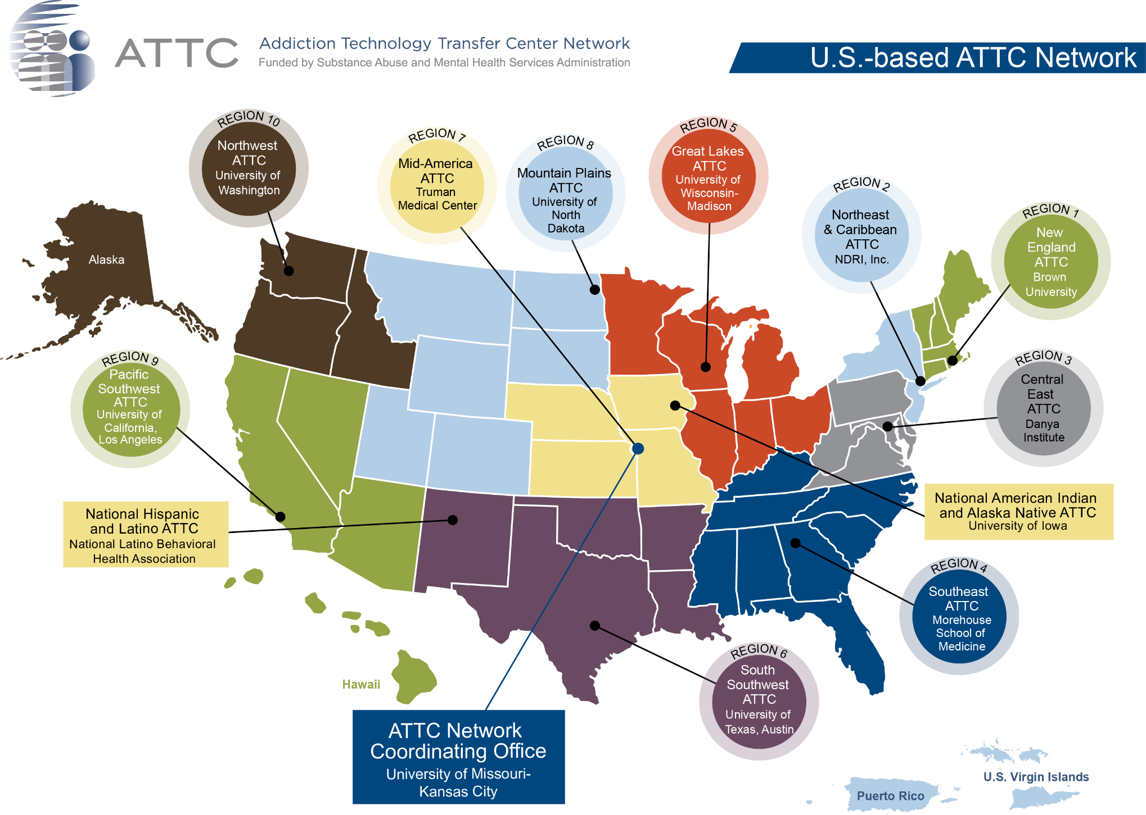

Slide 4
“If there is one thing you would like to learn today which would be helpful in your daily practice of group work, what would it be?”

Slide 5
Biography
Stephen R. Andrew, LCSW, LADC, CCS, MINT…
www.hetimaine.org www.dignitymaine.com
“storyteller”, trainer, author, group worker, therapist, community organizer…
Chief Energizing Officer of Health Education & Training Institute (HETI) and member of MINT (Motivational Interviewing Network of Trainers) since 2003. Certified Trainer by MINT in 2019. He has been a substance abuse counselor in a public-school system, and the Executive Director of an adolescent prevention/treatment agency. He is the co-founder of Agape Inc. which supports the Men’s Resource Center of Southern Maine whose mission is to support boys, men and fathers and oppose violence and Dignity for People using Opiates, a radical movement to change the conditions that promote the opiate epidemic in our communities. Stephen maintains a compassionate based private practice in Portland, Maine and facilitates support groups using empathy and compassion as the central principles for men’s, co-ed, woman’s and caregivers learning MI. He is the co-author of the book. “Game Plan: A Man’s Guide for Achieving Emotional Fitness” with two dear friends and producer of a podcast series: conversations in compassion. Stephen lives with his sweet wife, Hilary, lives in Portland Maine USA and is the proud father of twenty-three-year-old, Sebastian…

Slide 6
Guidelines for the Training...
Ask lots of questions.. Please make this relevant to your work..
Be mindful of each other. “Be kind” ...
Attitudes:
“What the Heck !!”, Jump into the experience….
Take a few risks..
Make Mistakes, “OOPS!”....
Confidentiality, make the training your experience...
Real play not Role play...
Please try to resist the “fixing” impulse…

Slide 7
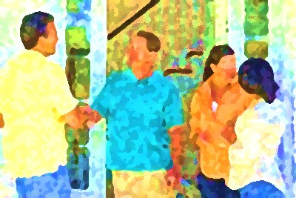
Introductions break outs, pairs…
Your name, listener repeat name
Tell me about the importance of this workshop…
One thing most people don’t know about you…
4 minutes…Summarize!!!!

Slide 8
What are you going to learn today ….
Motivational Interviewing Spirit, Partnership, Radical Acceptance, Compassion, Empowerment
Listening deeply and summarize what you have heard from the member & group as a whole..
Use open ended Questions to evoke change theory…
How to share information Ask them …Ask, Offer, Ask..
Dancing with discord, rolling with the resistance….

Slide 9
“People change through the heart, then through the mind..”
2018 CS

Slide 10
Meet and Greet.... (5min.)
Pairs breakout…
What are the challenges of group work, working with clients, patients, person we serve?
What are some of your “ WOW” moments for you working in groups?
What is a simple effective idea you taken away from working in groups and/or individuals?
LISTENER: OQ, R,R,…

Slide 11
concepts of exploration in conversation… Listen for power words to reflect..
awe…joy…
trust…
hope…
courage…
forgiveness…
gratitude…
regrets..shame…
And VALUES…
purpose..
CORE NEEDS- Love, power, capable..

Slide 12
Summarize
Be brief..

Slide 13
“PEOPLE WHO WERE HURT BY THE CROWD WILL BE HEALED BY THE CROWD”…
THEIR PARTICIPATION IN GROUP IS A TRANSFERENCE OF HOW THEY WERE TREATED BY THEIR FAMILIES, FRIENDS & COMMUNITY…
History and experience may dictate their ability to participate…

Slide 14
The nature of the conversation is critical
What we say - and how we say it–
and watching how it lands
largely determines what the person we serve says and what happens next…
goal of groups:
Increase Empathy & Compassion

Slide 15
Presence ..LISTEN well.(3min.)
Undivided Attention…
Listen with “soft” eyes, “warm” ears & “open” heart…
Radical Acceptance…
Silence...

Slide 16
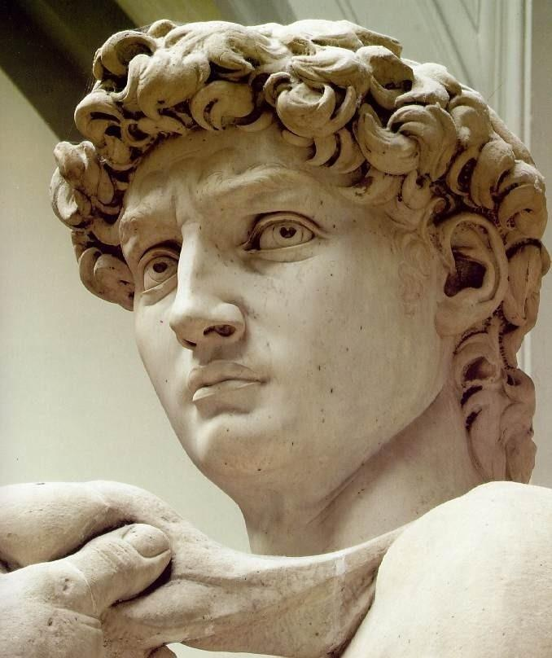
Statue of David
What is David thinking?
What is David feeling?
First response.
Empathy.
Notes:
Get into groups of 4 or so.
Pass out pictures of David
Ask group to brainstorm a list of things David might be thinking or feeling based on his expression and posture
Give them about 5-7 minutes to do so.
Make list of groups’ ideas on newsprint, reflecting what you hear as you go. One thought at a time from each group till all ideas are exhausted.
After the list is made review it.
Ask if anyone knows the story of the statues of David. If someone does, ask them to share it. If not tell the story which is:
Art historians believe the statue of David was Michaelangelo’s representation of David at the moment he saw Goliath on the battlefield.
Review the list and notice how much of what the group came up with, fits nicely with this scenario
Explain to group that they have just engaged in the process of making complex reflections. They were able to do so based on looking of a picture of a statue of David. Point out that we all “read” people in this way all the time and that the process of doing complex reflections is mainly about coming up with the courage to put our observations into words.

Slide 17
Individual & Group
Motivational Interviewing Similarities
Motivates change through resolving ambivalence & listening for “Change Talk”
Balances client-centered and directive elements moving through the 4 phases
Uses OARS & other MI Strategies
Avoids MI Non-adherent worker behaviors
Balances focusing and staying open…

Slide 18
Individual & Group
Motivational Interviewing Differences
Facilitating vs. interviewing
Group dynamics
Managing floor time
Managing different styles and beliefs across members
Eliciting group energy for change
Working with group members’ “righting reflexes” ( fixing impulse)

Slide 19
Motivational Interviewing Groups
the Possible Benefits
Universality
Inspiration
Peer support
Group momentum
Cost efficiency
Altruism
Cohesion…

Slide 20
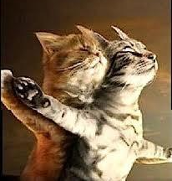
At the of
Motivational Interviewing spirit
Partnership –collaboration, coming along side.
Acceptance – unconditional regard, belief in the other’s right and the ability to make good choices for oneself, accurate empathic reflection, affirmation…
Empowerment – Listen and Elicit; the person we serve is the expert on him/herself…
Compassion – The desire to be with the suffering of the client, patient and/or person we serve…
“The worker is responsible for the intervention, not the outcome!”
Notes:
10 min

Slide 21
Let's go on a journey together you are the passenger client/person, the group is the driver

Slide 22
What motivated you?
Who has been a Change Agent in your life?
(relative, supervisor, teacher, coach, counselor, clergy person, friend, ect)
major positive influence
What were their characteristics/values?
What did they do?
Listener: OQ Rc, Rc..

Slide 23
Radical Acceptance
Partnership/
Collaboration
Compassion
Empowerment
Spirit of MI
Notes:
Not a ghost/haunted approach… way of being in MI
Miller story:
Drug abuse sx- abusers : in denial, not truthful, liars, don’t want to change
This was not his experience…. MI is BORN
And in studying MI in penal system- coding 100+ interview led by psychology trainees. …. Those most effective, eliciting had a rhythm= the spirit is born

Slide 24
Compassion …Miller Williams break outs pairs
Have compassion for everyone you meet, even if they do not want it … what seems like conceit, bad manners, sarcasm or cynicism is always a sign of things no ears have heard, no eyes have seen….for you do not know what wars are going on down there where the spirit meets the bone…
Pairs:
Listen well, more reflections than questions and then switch…(6 min.)
How will this guide you as a group facilitator?

Slide 25
“Motivational Interviewing
is an effective way of
Listening deeply and responding skillfully
with the people we serve & the group as a whole…”

Slide 26
What kind of groups are you running?
Psycho-educational
Process (interpersonal)
Therapeutic support groups..
Each require a different leader’s style
16

Slide 27
Forces
Clarity of purpose
a. for leader
b. for members
Relevance of purpose to the members’ needs.
Size of the group....
Length of each session
Adequacy of the setting
Time of the day ...
a. for leader
b. for members
Leader’s energy and attitude
Notes:
Why is this called forces?

Slide 28
Group Work Cohesion
Regular, punctual attendance
Standard process for people to join the group, “Saying Hello”
Attraction and warmth between group members
Active participation by each member
Self-disclosure and trust
Risk taking of new behavior
Tolerance of tension and ambiguity?
Shared belief about the purpose and norms
Spontaneous participation
Confidentiality
Termination/celebration process of members, “Saying Good bye”
SAFETY...
Notes:
Some data about the importance of cohesion;
Is there any data that suggest that MI increases cohesion (either in speed or in power)?

Slide 29
Group Work Skills
Sessional Tuning In.
Sessional Contracting.
Elaborating: Making The Story Fuller, Fatter.
Empathic Reflections for other Members.
Evoke Mutual Feelings from Members.
Demand For “ Change Talk.”
Pointing Out Strengths & Obstacles.
Sharing Information with Permission.
Holding The Rim, The Contract.
Beginnings, Endings And Transitions..
adapted from: Lawrence Schulman, Mutual Aid Groups,(1994), Columbia ‘JP.

Slide 30
Four Processes. “Structure of group”
 |  |  | Planning (Say good-bye well)
 |  | Evoking (maturity) “Meet people where they dream”
 | Focusing/Target Behavior (conflict, ambivalence, authority)
Engaging/Partnership (say hello well) “To understand another, be for my need to be understood”

Slide 31
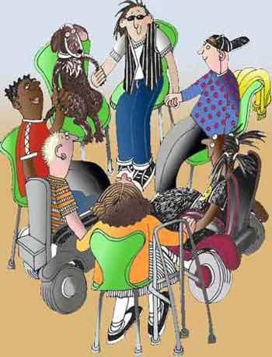
Group
work 1

Slide 32
Practice 1 (10 minutes )
5 people
Skills – Eliciting/Facilitating, OARS, Expressing Empathic Reflection, Agenda Setting- FOCUS
Group Skills – Guidelines, Initiating, Orienting, Building group identity through empathic refections..
Orientation – STRUCTURE!!!..2-4 min per participant..
Purpose, contract, plan agenda, affirm participation,
Focus on “Something you’d like to change and do not seem to? or.. How might you like things to be different?”…… “Saying hello…”
LINK with REFLECTIONS on THEMES, FEELINGS, IMPORTANCE & CONFIDENCE, PAIRS ETC.
“Meet people where they dream”

Slide 33
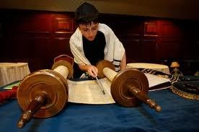
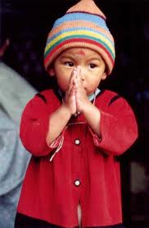
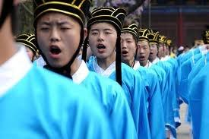
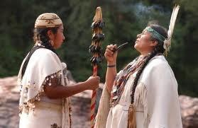
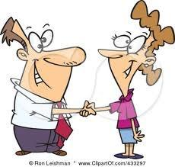
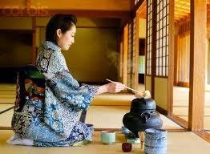
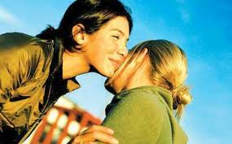
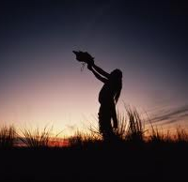
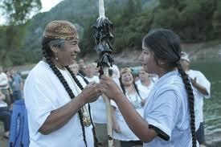
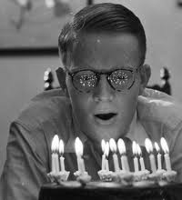
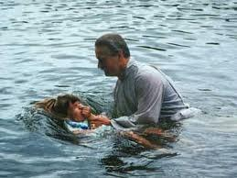
Building Rituals

Slide 34
Stress
Dreams
Fun & Recreation
?
Diet
YOU
Physical
Health
dental
Sleep
Spiritual
Practice
meditation
Exercise
Connection
family, friends

Slide 35
Summarize …(LEADER)
Be brief..

Slide 36
Observer…ask permission: May I share with you some of my thoughts on what I experienced?
What did they (Leaders) do well?
Observer: Motivational Interviewing; the spirit, structure & skills..

Slide 37
Group facilitation
Facilitator
Facilitator
communications
Rounds

Slide 38
Engagement Phase
Facilitator: one to one communications
Reflects on pairs, group as a whole..

Slide 39
Heighten Ambivalence
Facilitator
Increased empathy & compassion
intragroup communications
Listen for the conflict and the dreams in the individual & group as a whole….

Slide 40
Empowerment Phase
Listen for the “Change Talk”
Facilitator
High levels of autonomy & support
Intragroup communications strong without Leader
no Unsolicited advise, direction, judgements..
Lack of RIGHT positions…

Slide 41
Group Interventions
Provide specific Information with permission applicable to members’ lives about the focus of the group...
Involve everyone...
Keep the group moving; be careful about letting members dominate and /or silence...
Know that you are the conductor of anxiety...
Invite laughter into the group...
Be assertive about wanting people to come to group...

Slide 42
Group Interventions
Share support and help people solve their own patterns...
Develop “rituals” ...
opening
closing
go rounds
Serenity Prayer...
Hold 5 elements in your mind...
individual members’ needs
Link pairs in themes and similarities
cohesiveness of the group as a whole: feelings, themes, affection, empathy...
authority Issues: welcome them....
encourage empowerment (Change Talk)…
“REMEMBER NO ONE IS BROKEN”
Notes:
There should be an exercise about developing rituals…
I thought that the three things were: individual members’ needs, the interaction between members and the well-being of the group as a whole. Might authority issues be addressed in a slide about facilitator challenges?

Slide 43
What do you think are the strengths of the self protective patterns… pairs…7minutes
Domineering
Vindictive
Cold
Socially Avoidant
Exploitable
Overly Nurturing
Intrusive

Slide 44
Practice 2 (10 minutes)
Break outs…. 5 people
MI Skills – OARS & LINKING, Eliciting Change Talk, Focusing on Present and Future
Group Skills – Deepening emotional connection, deepening group cohesion through linking to others.. What is the ambivalence?
Theme – Values exploration as related to “issues”
Where are our conflicts within self or group?
What are some important values for you as a person? What are important desires, hopes to you as a person?
How could your values guide you in relation to your desires, hopes you choose & similar future situations

Slide 45
Observer: ask permission: May I share with you some of my thoughts on what I experienced?
Ask others in the group..
5 minutes break outs, groups..

Slide 46
The Power of Groups
sharing, having a voice
dialectical process
universality
mutual support
mutual demand
individual empowerment
evoking of hope through empathy
strength in numbers, confidence
skill of listening deeply
encouragement of autonomy
notion that no one is broken
Notes:
What is mutual demand?

Slide 47
Inside Fear…
&…Outside Willingness

Slide 48
Plan an activity
The General Wellness group has 8-10 minutes to plan a group activity to take place in a week from today…
ROLES in groups
Clown (brings humor)
Brain (Cute kid)
Hood (Self-hater)
Leader (Rock of Gibraltar)
Music Student (Star)
Stoner (Lone wolf)..
Nerd (Orphan)..
Filler…(talker) ..
Princess (I am the focus.)
Notes:
Headbands

Slide 49
Responding to discord
Part one: (small groups of 5)
Each participant writes two or three resistant/sustain “talk” statements that s/he has heard or might hear from his/her group member..
Part two:
One participant (the “client) reads his/her statement.
The participant next to him/her responds attempting to reduce the discord in the group…
The “client” replies and says whether it reduced, increased or didn’t affect his/her discord …. (one to five)
The next person…. and the next.. so on ..

Slide 50
Rolling with group challenges
“may this be in the service of compassion and acceptance”
What do you hear from group that challenges your authority and response?
Empathic reflection..and ask for what you need..
Radical humility..” I am sorry..”
Encourage/empower….
40

Slide 51
What People Can Get From Group
Learn to be in the here and now. Make contact with and tolerate feelings.
Get feedback.
Learn to take risks.
Be honest and tell their stories.
Become more sensitive to other people.
Learn about closeness, warmth, and intimacy.
Learn and experiment with new skills of relating to the world

Slide 52
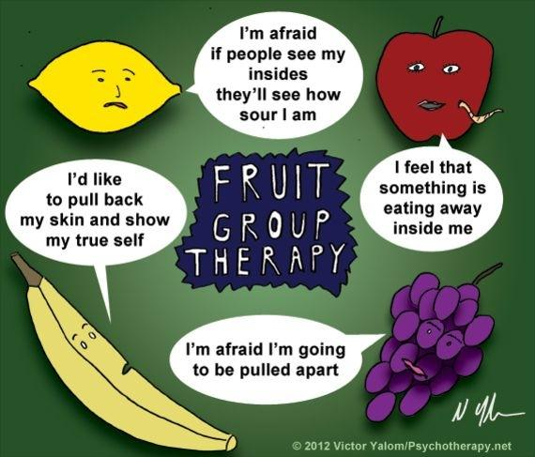

Slide 53
Practice 3 (10 minutes)
Break outs… 5 people
MI Skills/structure- O/EARS, wondering what members will do with the discord, EVOCATION and PLAN
Group skills- Supporting Self Efficacy: Change Success Stories, Pointing Out Strengths & Negative self-talk, Listen deeply for change talk & strengthen.
Theme - What do you want to do with this one wild precious life?
How do we “SAY GOOD-BYE”

Slide 54
Summarize Group Leader

Slide 55
Possible Group Work Topics
Introduction to Group
Ambivalence or Action
Looking Forward, Dreams
Advantage of staying the same or changing....
Exploring Values.. What is important? Value sort cards
Supporting Self Efficacy:
Change Success Stories
Supporting Self-Efficacy:
Exploring Strengths
Planning for Change
Importance, Confidence
for Change
Notes:
There could be an exercise for each of these
Topics I have added to my group: exploring our communities and taking our concerns out of the group (i.e., back to real life)

Slide 56
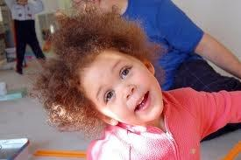
Statements ??
Questions??
Concerns?? Comments?? Cries of outrage??
Bad Jokes??
Notes:
Différences et similitudes entre l’individuel et le groupe
Les règles de la co-animation

Slide 57
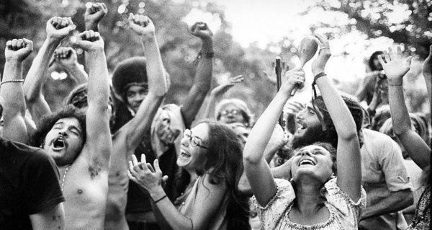
Key Learnings..
Take aways..

Slide 58
Thank You! One thing you liked... One thing you relearned... One thing you learned…
What’s next ?
Stephen R. Andrew
LCSW LADC CCS CGP MINT
www.hetimaine.org

Slide 59
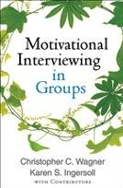
References

Slide 60
References
Books
Motivational Interviewing: Third Edition: Helping People Change, William R. Miller and Stephen Rollnick
Motivational Interviewing in Groups, Christopher C. Wagner and Karen S. Ingersoll, with Contributors
Motivational Interviewing in the Treatment of Psychological Problems, Edited by Hal Arkowitz, Henny A. Westra, William R. Miller, and Stephen Rollnick
Calling the Circle: The First and Future Culture, Christina Baldwin
Game Plan: A Man’s Guide to Achieving Emotional Fitness. Lyme Allan., Powell, David., Andrew Stephen.,Central Recovery Press, Las Vegas NV.
Websites
www.motivationalinterviewing.org
www.hetimaine.org
Website of Health Education and Training Institute (HETI) HETI is located in beautiful Portland, Maine and is run by Stephen Andrew, an incredibly effective and enjoyable trainer. and sweet 7 person MITI simulation coding/coaching Lab..

Slide 61
Power of Groups Bibliography
Duffy, T. K (1994). The Check-In and Other Go-Rounds in Group Work: Guidelines for Use. Social Work with Groups, 17(1/2), 163-175.
Fisher, Sr., M. S. (1995). Group therapy protocols for persons with personality disorders
who abuse substances: Effective treatment strategies. Social Work with Groups 18(4) 71
Hellerstein, D. & Meehan, 6. (1987). Outpatient group therapy for schizophrenic substance abusers American Journal of Psychiatry. 144, 1337-1339
McHugo, G. J., Drake, R. E., Burton, H. L & Ackerson, T.H. (1985). “A scale for assessing the stage of substance abuse treatment with severe mental Illness.” Journal of Nervous and Mental Disorders, 183(12).
L Montrose. K. & Daley, D. (1995). Celebrating Small Victories. Center City, MN: Hazelden.
Pollio, D., McDonald, S., & North, C. (1996). Combining a strengths-based approach and feminist theory in group work with persons “on the streets.’ Social Work with Groups 19(3/4), 5-20
Rogers, R. L & McMiIlin, C. S. (1989). The Healing Bond: Treating Addictions in Groups. New York: Norton.
Walsh, J., & Hewitt. H. (1996). Facilitating an effective process In treatment groups with persons having serious mental illness. Social Work with Groups (19(1), 5-18.

