Slide 1
SAMSHA’s National Outcome Measures Service Tool: Collecting Sexual Orientation, Gender Identity, and Race/Ethnicity Demographic Information in a Culturally Humble and Sensitive Approach
David G. Zelaya, Ph.D.
Equity, Diversity, and Inclusion Director
Wednesday January 25th 2023
Notes:
Place your title on this first slide and include any subtitle.
DO NOT CHANGE THE FORMAT OF THIS TEMPLATE. If you are creating ATTC-branded slides, you must use this template. If you move around boxes, make sure to check the reading order. If you widen any boxes they must not overlap any other box.
IF YOU ADD ANY GRAPHICS, you will need to add ALT TEXT and check READING ORDER.
(If the notes on ALT TEXT and READING ORDER do not make sense to you, please let the ATTC National Coordinating Office know to help with remediation.)

Slide 2
Disclosures
The development of these training materials were supported by grant H79 TI080209 (PI: R. Martin) from the Center for Substance Abuse Treatment, Substance Abuse and Mental Health Services Administration, United States Department of Health and Human Services. The views and opinions contained within this document do not necessarily reflect those of the US Department of Health and Human Services, and should not be construed as such.
Notes:
If someone else is looking over your presentation, make sure they do not rearrange, add, or delete anything on your slide. This will mess up the template and reading order. Have them use the comment feature found under the Review tab.
You can locate the accessibility checker by selecting “File,” “Check for Issues,” “Check Accessibility.” On a Mac, you can find this under “Tools,” “Check Accessibility” or under “Review,” “Check Accessibility.”

Slide 3
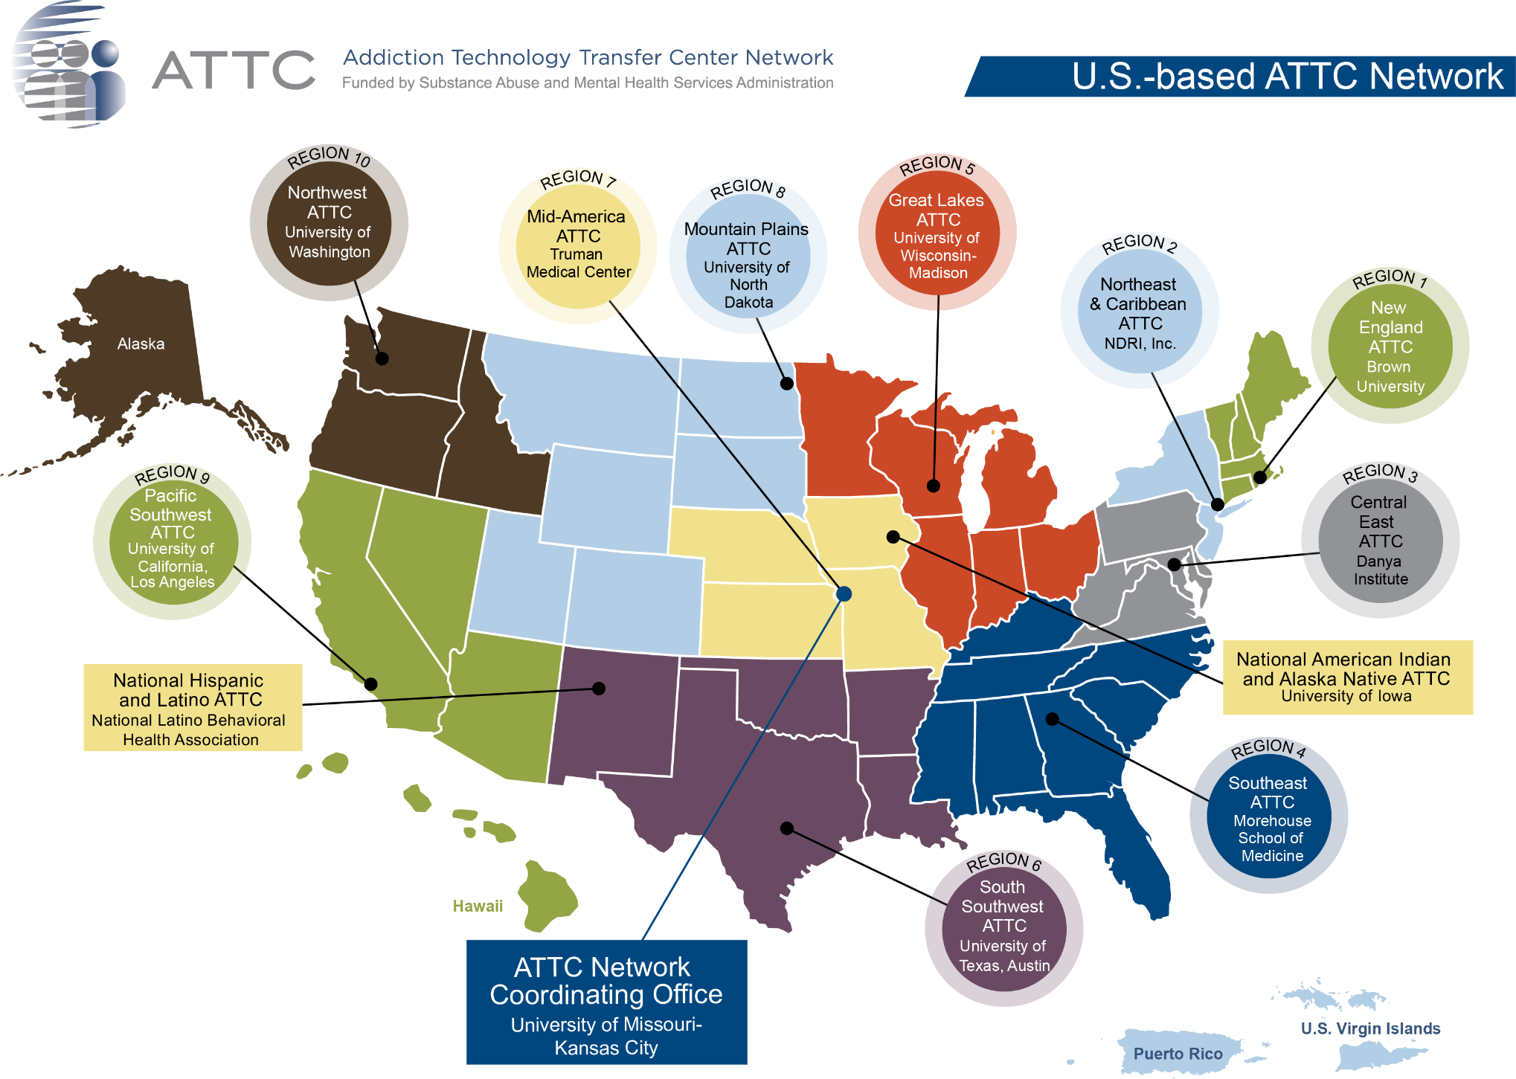

Slide 4
Social Positionality Statement
A note on reflexivity…

Slide 5
Social Positionality Reflection
Identity is complex
Identity is contextual
Provides lens through which we see research and provide clinical care
Your place in space

Slide 6
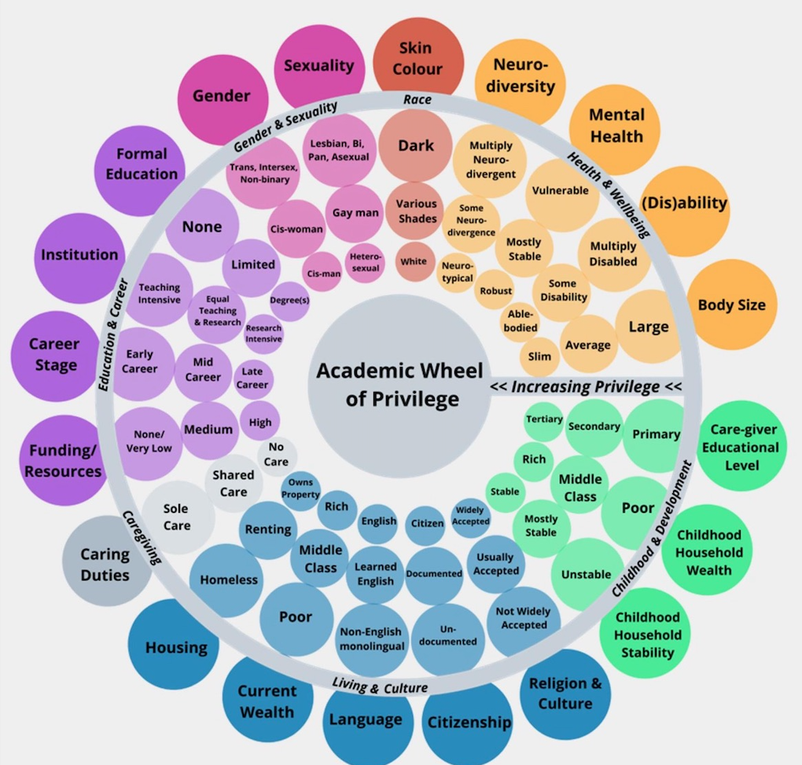
Social Positionality Reflection
What are yours?
(Azevedo, 2022)

Slide 7
Agenda
Sexual Orientation and Gender Diversity Language
Cultural Humility
Q&A/ Experiential Activity

Slide 8
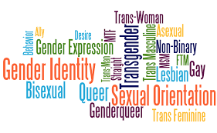

Slide 9
Sexual Orientation and Sexual Minority Communities
Sexual Orientation: inherent emotional, romantic, or sexual attraction to other people (sexual orientation is independent of gender identity)
Sexual Identity: how we perceive and call ourselves (e.g., straight, gay, bi). Sexual identity and sexual behavior can be chosen, unlike sexual orientation.
Questioning: term used to describe people in the process of exploring sexual orientation (or gender identity)
(HRC; accessed 2023)

Slide 10
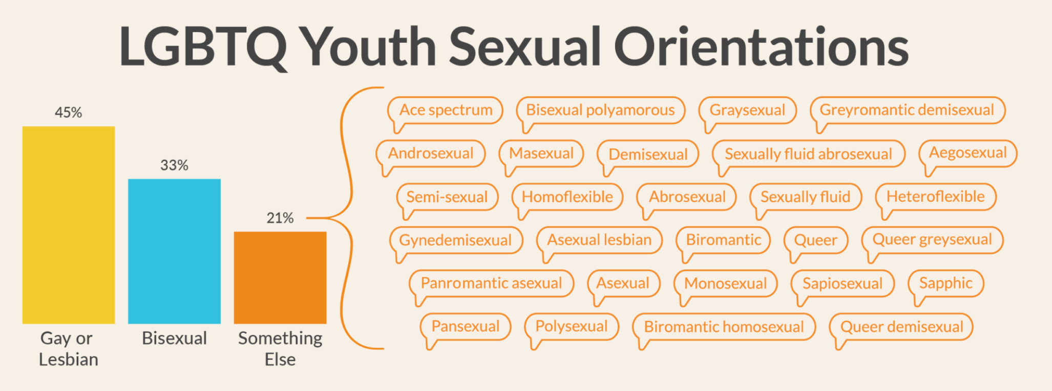
Terminology – Sexual Minorities
(The Trevor Project, 2019)

Slide 11
Gender Identity and Gender Minority Communities
Transgender Man, Trans Man: a man assigned female at birth may use this term. Some may simply use man without a modifier.
Trans Masculine: assigned female at birth who is closer to masculinity than femineity but is not a binary man.
Transgender Women, Trans Women: a woman assigned male at birth may use this term. Some may simply use woman without a modifier.
Trans Feminine: assigned male at birth who is closer aligned femininity than masculinity but is not a binary woman.
Not all trans folks are are feminine or masculine identified.
(PFLAG & GLAAD accessed 2023)

Slide 12
Gender Identity and Gender Minority Communities
Transition: process during which a person changes their gender expression and/or sex characteristics. This may include changing pronouns, changing one’s name, taking estrogen or testosterone, gender confirmation surgeries
Social, legal, medical
Gender Identity: One’s internal sense of being male, female, neither of these, both, or other gender(s). Everyone has a gender identity, including you. For trans folks, their sex assigned at birth and their gender identity are not necessarily the same
(PFLAG & GLAAD accessed 2023)

Slide 13
Gender Identity and Gender Minority Communities
Nonbinary: A gender identity that denotes someone who does not fully identify with the binary genders of male/man/masculine or female/woman/feminine. A nonbinary person may identify as neither a man nor a woman, in-between, both, fluidly moving between these two categories, or as a third/alternate gender
Genderqueer: term that is used by individuals who do not identify as solely male/man or female/woman. Blur perceived boundaries of gender.
(PFLAG & GLAAD accessed 2023)

Slide 14
Gender Identity and Gender Minority Communities
Gender Dysphoria: Emotional distress related to the sense that one’s assigned sex is not in line with one’s gender identity. Gender Dysphoria is also a medical and mental health diagnosis that may warrant treatment in the form of gender-affirming medical interventions.
Cisgender, Cis: Someone whose gender identity corresponds with expectations based on the sex they were assigned at birth. For example, a person who was assigned female at birth and identifies as a woman is regarded as cisgender or as a cisgender woman.
(PFLAG & GLAAD accessed 2023)

Slide 15
Gender Identity and Gender Minority Communities
Gender Expression: individual’s characteristics and behaviors such as appearance, dress, mannerisms, speech patterns and social interactions that are typically perceived as masculine or feminine
Coming out: The process of becoming aware of one’s sexual orientation or gender identity, accepting it, acting on it, and telling others. This process usually occurs over time and in stages. This process may occur in a different order depending on each individual. Typically it may be described as a lifelong, dynamic process.
(PFLAG & GLAAD accessed 2023)

Slide 16
Gender Identity and Gender Minority Communities
Dead name: the birth name of somebody who has changed their name. mostly commonly attributed to trans people, but can be attributed to any person who has changed their name
Outing:

Slide 17
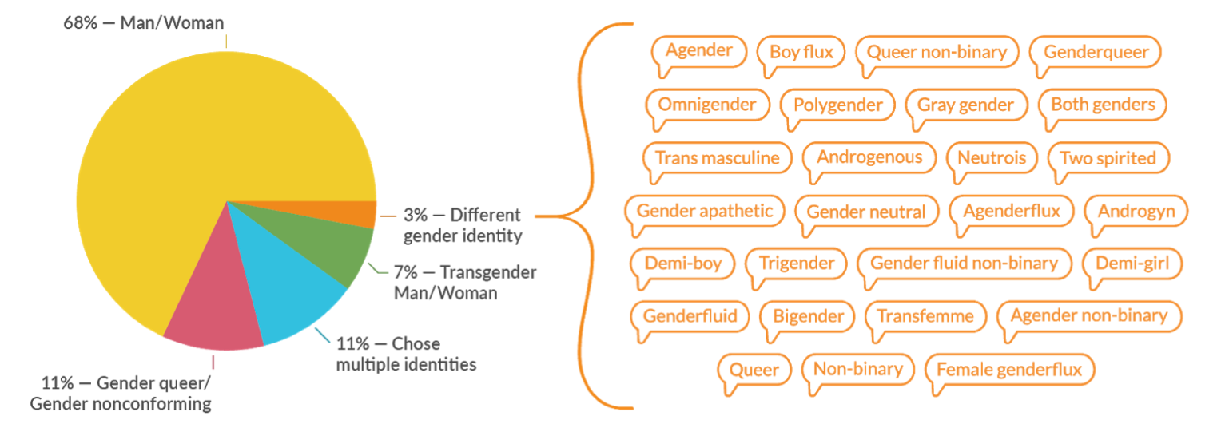
Terminology – Gender Minorities
(The Trevor Project, 2019)

Slide 18
Common Sexual Orientation and Gender Identity Microaggressions in Clinical Setting
Endorsement of heteronormative and gender normative culture and behaviors
Discomfort with or disapproval of the LGBTQ experience
Assumption of Universality (e.g., heterosexual or cisgender)
Exoticization
Denial of heterosexism/transphobia
(Shelton & Delgado-Romero, 2013)
Notes:
Shelton and Delgado Romero, 2013

Slide 19
Misgendering
the experience of not having one’s social identity correctly recognized by others; reflects a failure to have one’s social identity accurately verified by others
ASK PRONOUNS

Slide 20
MISGENDERING A PATIENT
Calling a patient by the incorrect pronouns
Form of Micro/Macro Aggression
What to do?
Apologize sincerely
Process
Colluding with systemic oppression?
Notes:
or the experience of not having one’s social identity correctly recognized by others, is psychologically disruptive ; reflect a failure to have one’s social identity accurately verified by others

Slide 21
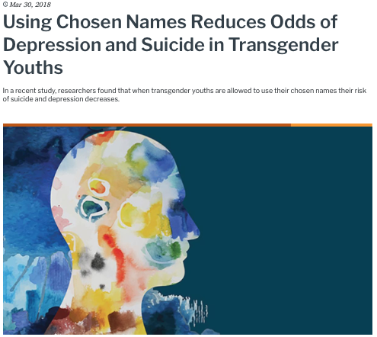
(Russell et al., 2018)

Slide 22
Suggestions…
Avoid:
Birth sex/ natal sex
Born a girl/ born a boy
Instead try:
Assigned sex/ sex assigned at birth
Assigned female at birth/ assigned male at birth
Transgender people
Tranny
"Marisol was born a man but identities as a woman"
”Marisol is a transgender woman.”
"The clinic offers services for female-to-male patients"
“The clinic offers services for trans men.”
(APA, 2021)

Slide 23
Agenda
Sexual Orientation and Gender Diversity Language
Cultural Humility
Q&A/ Experiential Activity

Slide 24
Setting the stage for cultural humility…
Congruence (real, authentic, and genuine)
Unconditional Positive Regard
Empathic Understanding

Slide 25
Setting the stage for cultural humility…
Congruence (real, authentic, ang genuine)
Unconditional Positive Regard
Empathic Understanding

Slide 26
Setting the stage for cultural humility…
Congruence (real, authentic, ang genuine)
Unconditional Positive Regard
Empathic Understanding

Slide 27
Cultural Humility

Slide 28
Cultural Humility
Multicultural orientation
Cultural Competency
Knowledge
Attitudes
Awareness
Skills
Lifelong learning
Holding institutions accountable
Recognizes power imbalance

Slide 29
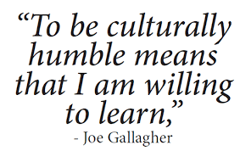
Cultural Humility during a clinical interview
A | Ask questions in a humble, safe manner
S | Seek self-awareness
S | Suspend judgement
E | Express kindness and compassion
S | Support a safe and welcoming environment
S | Start where the patient is at

Slide 30
CULTURAL HUMILITY
Acknowledge own limitations
JUST ASK
Seek consultation
Multicultural Competence vs. Multicultural Orientation
Other-oriented stance
Develop deeper awareness of self:
Privilege
Biases
Values
Cultural Humility: Engaging Diverse identities (2017) in Therapy by Hook, Davis, Owen, and DeBlaere.
Notes:
Cultural Humility: Engaging Diverse identities (2017) in Therapy byHook, Davis, Owen, and DeBlaere.
Acquisition of knowledge and skills to work with people from diverse backgrounds.
The helper’s way of being with others based on the helper’s values and philosophy regarding the value of culture in people’s lives.
Cultural humility is a core facet of multicultural orientation.

Slide 31
Get to know your patients…
Seeking to learn about our patients not based on assumptions
Notes:
HCP could seek to learn about the individual in the clinical arena, based not on assumptions (eg, lesbians and transgender men are not at risk of cervical cancer) but on their actual, lived history
A transgender person often must navigate both the health care and legal systems to change gender markers on their birth certificate, driver’s license, and passport, because some states or jurisdictions require medically certified docu- mentation confirming that an individual has undergone or is undergoing gender transition through cross-gender hormones and/or surgery

Slide 32
Agenda
Sexual Orientation and Gender Diversity Language
Cultural Humility
Q&A/ Experiential Activity

Slide 34
What concerns do you have around asking these questions of clients?

Slide 35
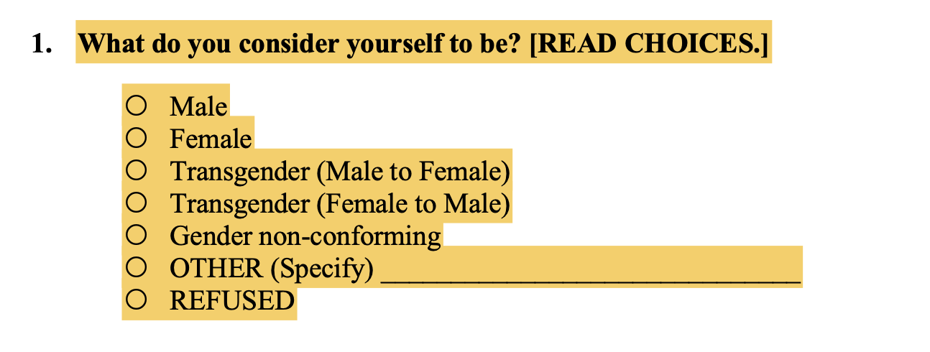
Best practice recommends to always ask, and use, the term that a person prefers
Male-to-Female and Female-to-Male are outdated terms

Slide 36
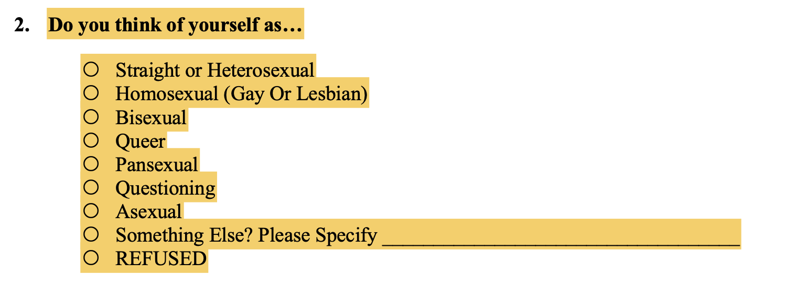
Straight/heterosexual is first (implies heterosexuality is the norm and default), I’d recommended asking in alphabetical order

Slide 37
Tips for creating an inclusive environment…
Share your pronouns with everyone
Incorporate inclusive language (e.g., ‘hi everyone’ vs. ‘hey guys’; ‘parent/legal guardian’ vs ‘mom and dad’)
Know general definitions when talking about gender identity and sexual orientation

Slide 38
Tips for creating an inclusive environment…
Include diverse LGBTQ+ themed posters
Don't assume and educate yourself
Don’t be afraid to make mistakes

Slide 39
Q&A
Concerns in asking demographic questions?
Clarifying questions?

Slide 40
Role Play
We will take turns asking questions…
Volunteers?!

Slide 42
Human Rights Campaign

Slide 43
The Trevor Project

Slide 44
American Psychological Association

Slide 45
Resources
Human Rights Campaign
https://www.hrc.org/resources/glossary-of-terms
The Trevor Project
https://www.thetrevorproject.org/resources/
American Psychological Association
https://www.apa.org/about/apa/equity-diversity-inclusion/language-guidelines.pdf

Slide 46
Thank you! david_zelaya@brown.edu

