Slide 1
Eliminating Disparities, Building Equity, and the Enhanced CLAS Standards: Current Context and Approaches
Haner Hernandez, PhD, CPS, CACII, LADCI
Notes:
Place your title on this first slide and include any subtitle.
DO NOT CHANGE THE FORMAT OF THIS TEMPLATE. If you are creating ATTC-branded slides, you must use this template. If you move around boxes, make sure to check the reading order. If you widen any boxes they must not overlap any other box.
IF YOU ADD ANY GRAPHICS, you will need to add ALT TEXT and check READING ORDER.
(If the notes on ALT TEXT and READING ORDER do not make sense to you, please let the ATTC National Coordinating Office know to help with remediation.)

Slide 2
Historical Context
Punitive Approaches (Criminal Justice Approach to a Public Health Problem)
Main Focus and Onus on Individuals
________________________________________________________
Disparities and Inequities
Focus on Eliminating Disparities, Structural Determinants of Health, and Leading with Equity

Slide 3
Disparities
“Particular type of health difference that is closely linked with social, economic, and/or environmental disadvantage. Health disparities adversely affect groups of people who have systematically experienced greater obstacles to health based on their racial or ethnic group; religion; socioeconomic status; gender; age; mental health; cognitive, sensory, or physical disability; sexual orientation or gender identity; geographic location; or other characteristics historically linked to discrimination or exclusion.” Healthy People 2030
Notes:
Of course you know that using these templates does not mean that your presentation is 508 compliant. There is much more to making a presentation 508 compliant than just using templates. However, if you use these slides it makes remediation easier and quicker.

Slide 4
Examples of Disparities
Health Insurance
Access to the Continuum of Care and Quality Thereof
Opioid Overdose Deaths
HIV/AIDS
HCV – Hep C
Covid-19
Education
Criminal Justice and Incarceration
Housing
Employment
Behavioral Health Workforce
Others

Slide 5
Structural and Social Determinants of Health (SDOH)
Structural and Social Determinants of Health are conditions in the environments in which people are born, live, learn, work, play, worship, and age that affect a wide range of health, functioning, and quality-of-life outcomes and risks.
Healthy People 2030 states that our goal should be to: “Create social and physical environments that promote good health for all.”

Slide 6
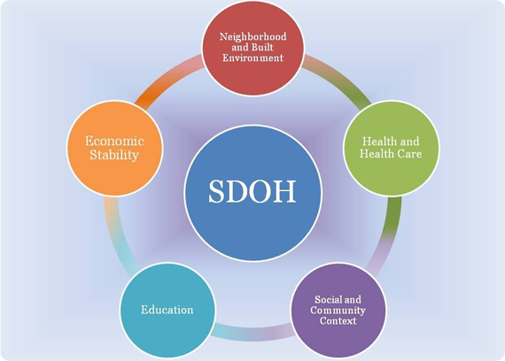
Five Key Areas of the SDOH

Slide 7
Changes, Approaches, Tools, and Actions…..

Slide 8
Cultural Humility and Humanization
“Cultural Humility incorporates a lifelong commitment to self-evaluation and self critique to redressing the power imbalances in the patient-physician dynamic and to developing mutually beneficial and non-paternalistic clinical and advocacy partnerships with communities on behalf of individuals and the defined population.”
(Tervalon and Murry-Garcia, 1998)

Slide 9
Cultural Self-Assessments
Developed for individuals and organizations
Gauge the degree to which you are effectively addressing the needs of culturally and linguistically diverse groups
Determine your strengths and areas for growth
Plan strategically for the systematic incorporation of culturally and linguistically competent policy, structures, and practices
Source: National Center for Cultural Competency, https://nccc.georgetown.edu

Slide 10
Health Equity
“Behavioral Health Equity is the right to access quality health care for all populations regardless of the individual’s race, ethnicity, gender, socioeconomic status, sexual orientation, geographical location and social conditions through prevention and treatment of mental health and substance use conditions and disorders.” SAMHSA, 2017

Slide 11
Federal Changes Related to Harm Reduction Policies and Practices
SAMHSA, CDC, ONDCP Convened a 2 Day Summit on Harm Reduction in December of 2021
Harm Reduction Defined, Principles and Pillars Established
Steering Committee Established and Providing Direction
National Harm Reduction Technical Assistance Center Established
30 Million in Initial Funding Made Available; More to Follow!

Slide 12
Multiple Pathways of Recovery
23* Million People Identify as Being in Recovery
Peer Movement, Integration into the Workforce, and Improved Outcomes
Menu Options, Voice, Agency, and Self-Determination

Slide 13
Purpose of the Culturally and Linguistically Appropriate Services (CLAS) Standards
“The Enhanced CLAS Standards are intended to advance health equity, improve quality of care and help eliminate health care disparities by providing a blueprint for individuals and health and health care organizations to implement culturally and linguistically appropriate services.”
Office of Minority Health 2013

Slide 14
Enhanced CLAS Standards
Principle Standard:
Provide effective, equitable, understandable and respectful quality care and services that are responsive to diverse cultural health beliefs and practices, preferred languages, health literacy and other communication needs.

Slide 15
CLAS Three Broader Themes
Theme 1: Governance, Leadership and Workforce (Standards 2-4).
Theme 2: Communication and Language Assistance (Standards 5-8).
Theme 3: Engagement, Continuous improvement and Accountability (Standards 9-15).

Slide 16
Muchas Gracias - Thanks

