Slide 1
Incorporating an Intersectionality Framework to Understand the Impact of Racism and Heterosexism on the Health Disparities Encountered by LGBTQ+ People of Color
David G. Zelaya, Ph.D.
Assistant Professor
Brown University School of Public Health
New England ATTC
Equity, Diversity, and Inclusion Director

Slide 2
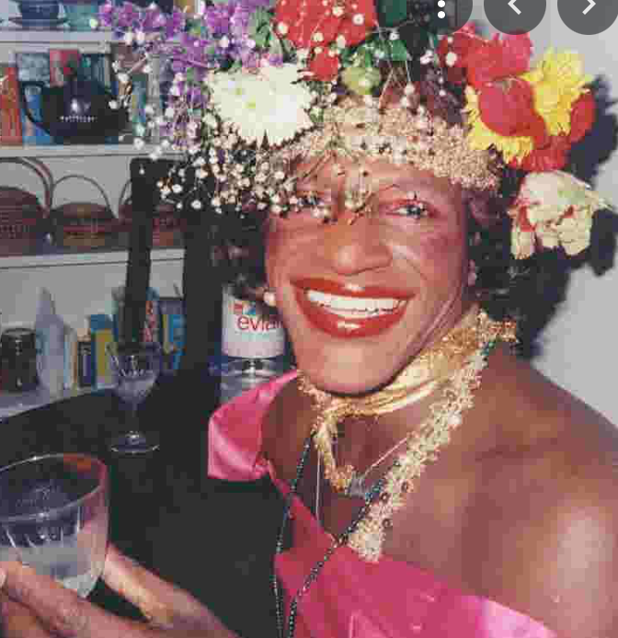
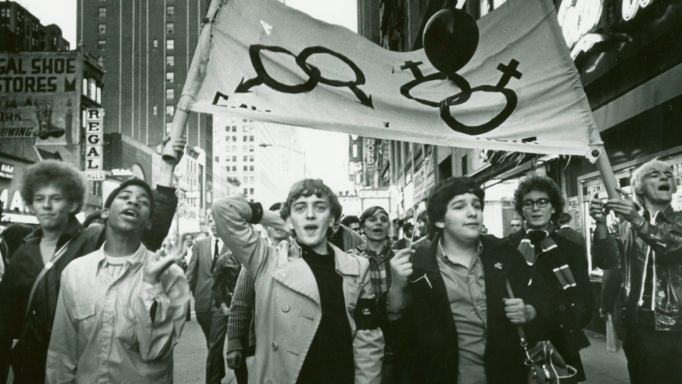
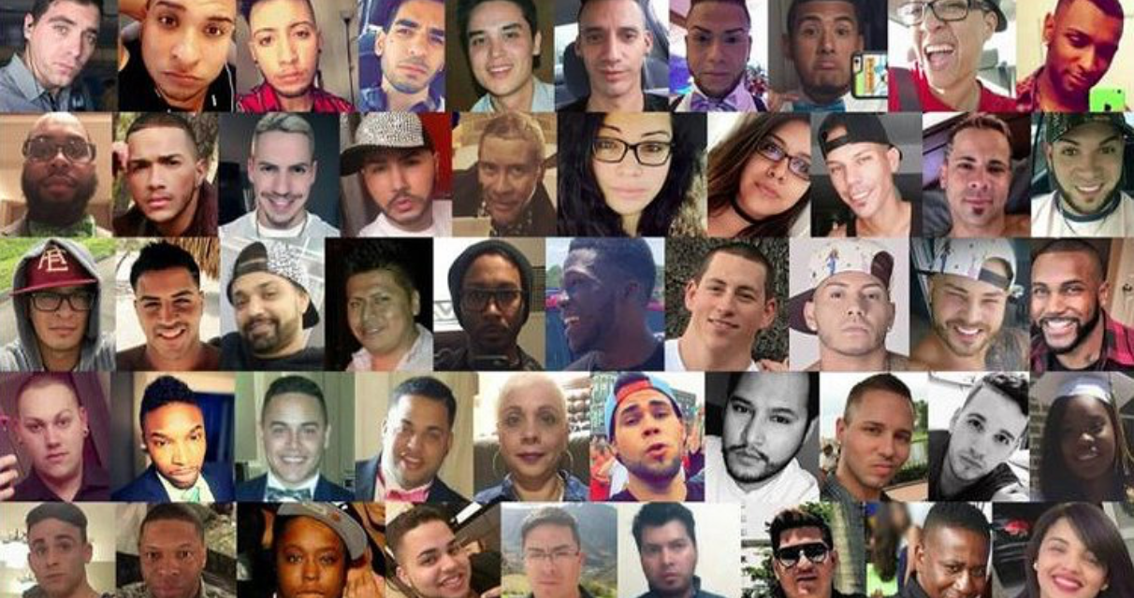

Slide 3
Agenda
Introduction
Terminology
Intersectionality
Minority stress
Stressors & Health Disparities
Cultural humility
Evidence-Based Interventions (or lack thereof)

Slide 4
Questions to hold
What’s the difference between race vs. racism; sexual orientation vs heterosexism; gender identity vs. cis-sexism?
What unique factors do racial, sexual and gender minorities face in healthcare? And those living at the intersections?
How do systems of oppressions impact healthcare and health outcomes?
How might your own positionality impact your work?

Slide 5
Terminology

Slide 6
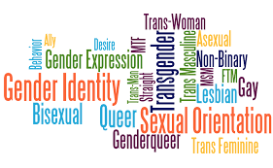
Sexual Orientation ≠ Gender Identity

Slide 7
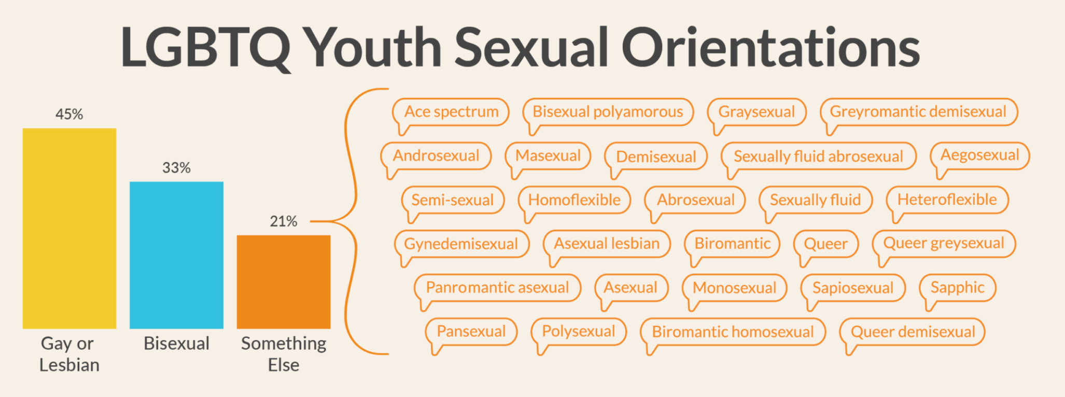
Sexual Orientation terminology…

Slide 8
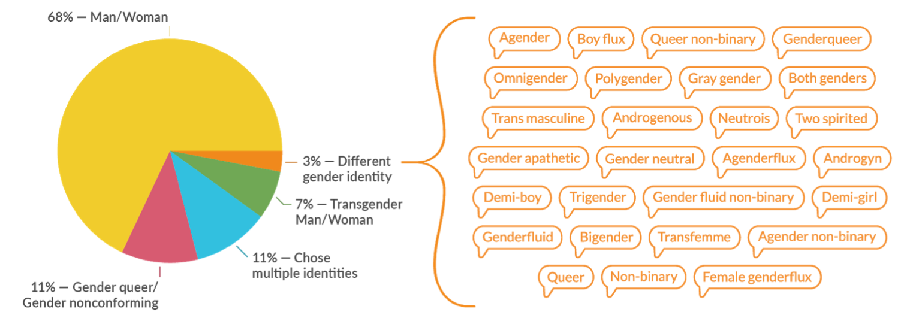
Gender Identity Terminology…

Slide 9
ASK

Slide 10
Health Disparities
“A health disparity is a particular type of difference in health (or in the most important influences on health that could potentially be shaped by policies); it is a difference in which disadvantaged social groups—such as the [low ses], racial/ethnic minorities, women, or other groups who have persistently experienced social disadvantage or discrimination—systematically experience worse health or greater health risks than more advantaged social groups.”
Braveman et al., 2006

Slide 11
"Intersectionality is a metaphor for understanding the ways that multiple forms of inequality or disadvantage sometimes compound themselves and create obstacles that often are not understood among conventional ways of thinking.”
Intersectionality
(Crenshaw, 1989)

Slide 12
Minority stress theory posits that having a marginalized or stigmatized identity creates unique sociocultural chronic stressors, which impact mental and physical health.
Minority Stress
(Meyer, 1995)
Notes:
sexual minorities are twice as likely to experience a hate crime (i.e., Pulse Nightclub shooting) compared to their heterosexual counterparts

Slide 13
Systems of Oppression & Intersectionality

Slide 14
The 4 I’s of Oppression
Health Disparities
Ideological
Institutional
Interpersonal
Internalized
(Jones, 2002)

Slide 15
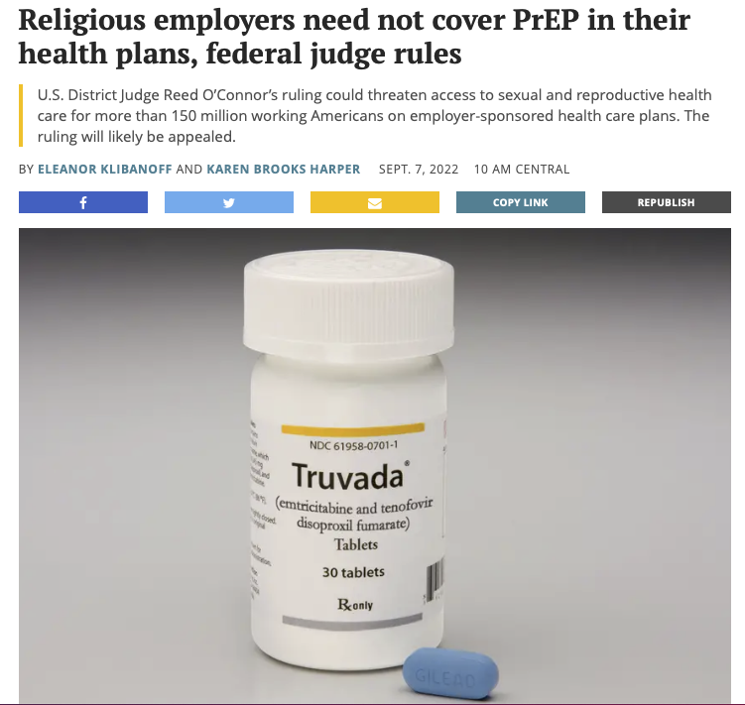
Ideological
Oppression
Institutional
Oppression
Black MSM represented 14% of PrEP users in 2021, but 42% of new HIV diagnoses in 2020.
Hispanic/Latinx MSM represented 17% of PrEP users in 2021 and 27% of new HIV diagnoses in 2020.
White MSM represented 65% of PrEP users and 26% of new HIV diagnoses.
(AIDSVU, 2022)
Notes:
Some decline in White and Black folks but none in Latinx

Slide 16
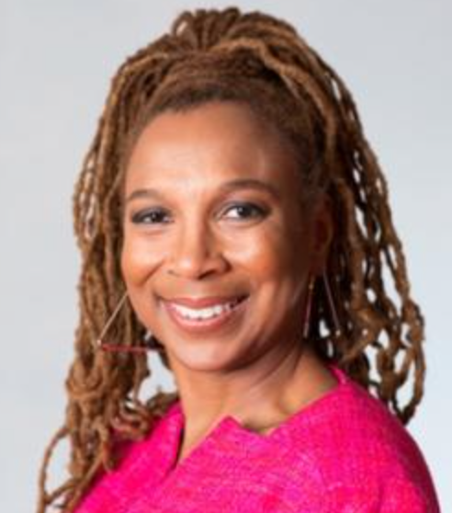
Intersectionality
Intersecting identities ≠
Intersectionality
Notes:
is a concept and critical analytic perspective that has its roots in the scholarship and activism of Black women and other Women of color
of oppression are co-constituted—that is, beyond just co-occurring, systems of oppression mutually influence each other

Slide 17
Intersectionality
“Concept denotes various way in which race and gender interact to shape the multiple dimensions of Black women”
“Women of color are differently situated in the economic, social, and political worlds...where systems of race, gender, and class domination converge”
“Women of color are situated within at least two subordinated groups that frequently pursue conflicting political agendas”
Cumulative ways in which discrimination combine, overlap, and intersect not isolated and distinct (e.g., misogynoir)
Notes:
add how its been expanded to include qpoc

Slide 18
Intersectional Invisibility
Intersectional invisibility
Androcentrism
Ethnocentrism
Heterocentrism
Ciscentrism
Notes:
what is it?
less protoyptical identities, further pushed to the margins
more people experience different types of oppression, such as cultural imperialism, marginiazaltion, violence, exclusion. consdier your own patients? implications for research? evidence based?

Slide 19
Conceptual Lens for Health Disparities: Minority stress
Unique form of stress in addition to everyday stress that is experienced by marginalized groups
Chronic- related to underlying social and cultural structures (i.e., oppression)
Socially based- meaning is happens from social processes, institutions, and structures outside of the individual

Slide 20
Conceptual Lens: Minority stress
Socially Marginalized Identity
Chronic forms of stress
Deleterious Mental and Physical Outcomes
Proximal
Distal
Harassment
Discrimination
Victimization

Slide 21
Minority Stress: Health Disparities
Minority Stress
Substance Use (e.g., Lea et al., 2014)
Psychological Distress (e.g., Balsam et al., 2011)
Lower Physical Health (e.g., Frost, et al., 2015)

Slide 22
Minority Stress: Proximal & Distal Stressors
Proximal
Internal, subjective experiences that rely on the individual’s perceptions and appraisals within their environment
Concealment of sexual identity
Distal
Objective events and conditions in the individual’s environment
Structural stigma (e.g. marriage inequality)
Internalized stigma
Rejection sensitivity
Prejudice-based events such as overt discrimination
Antigay victimization or violence

Slide 23
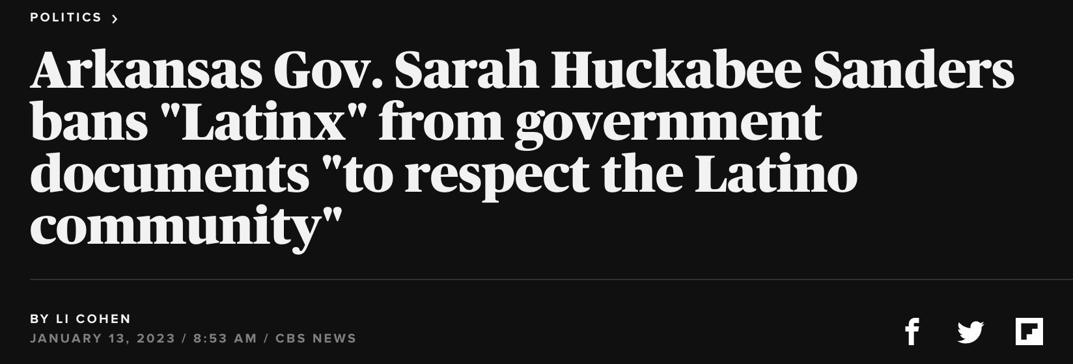
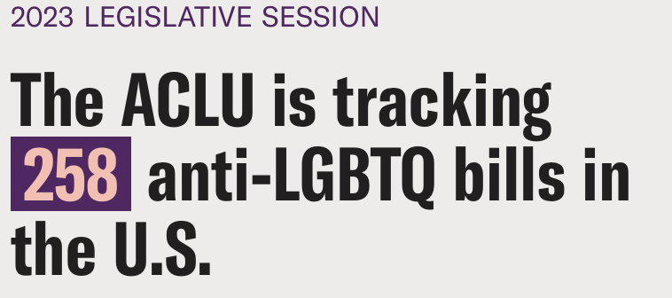
Current climate (proximal/distal stressors)…

Slide 24
Manifestations of historical trauma and interlocking systems of oppression
Stressors & Health
Disparities

Slide 25
Unique Stressors

Slide 26
People of Color Stressors
Poverty
Acculturative stress
Education & Employment
Colorism
Trauma
Language barriers
Documentation
status
Health Insurance

Slide 27
LGBTQ+ Stressors
Minority Stress
Internalized heterosexism
Victimization
Rejection/Rejection sensitivity
Discrimination in healthcare/workplace settings
Violence
Notes:
look diff from previous

Slide 28
Racism within the LGBT community
Heterosexism within Communities of Color
Racism in Close Relationship and Dating
Queer People of Color Stressors
Balsam et al., 2011

Slide 29
Health Disparities

Slide 30
NIH Health Disparity Groups
Sexual and Gender Minorities- Heterosexism & Cis-sexism
Queer People of Color
Racial and Ethnic Minorities- Racism
Notes:
define who counts as a health disparity group; add latinx

Slide 31
Health Disparities: Alcohol Use
Notes:
60 percent: Percent of LGB Latino adults who report alcohol abuse, compared to only 33 percent of the Latino heterosexual population.
Black and Hispanic sexual minority women reported the highest prevalence of binge drinking (45.4% and 43.4%, respectively), followed by White sexual minority women (35.7%) and White heterosexual women (23%).

Slide 32
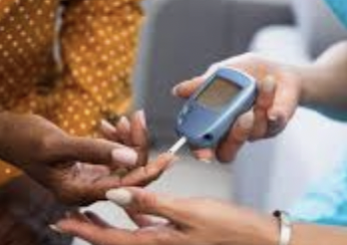
Health Disparities: Diabetes
Notes:
20 percent: Percent of LGB African-American adults who have diabetes, a rate 2.5 times higher than the rest of the African-American population and four times more than white LGB and heterosexual individuals.

Slide 33
Health Disparities: Mammograms
Notes:
35 percent: Percent of LGB African-American women who have had a mammogram in the past two years, compared to 57 percent of all LGB women and 62 percent of all heterosexual women.

Slide 34
Health Disparities: Psychological Distress
Notes:
25 percent: Percent of LGB Asian or Pacific Islander adults who experience psychological distress, a rate more than four times higher than heterosexual Asians and Pacific Islanders and 2.5 times more than the general heterosexual population.
proportion of LGBTQ youth reporting a suicide attempt in the past year was higher among youth of color (21%) than White non-Hispanic youth (18%).
American Indian/Alaskan Native LGBTQ youth were 2.5 times more likely to report a suicide attempt compared to White non-Hispanic LGBTQ youth.

Slide 35
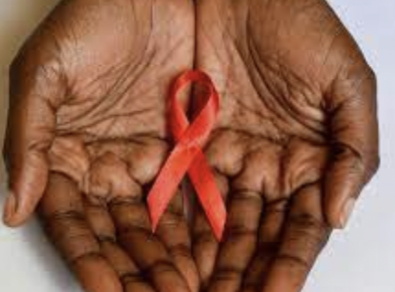
Health Disparities: HIV & PrEP
Notes:
29 percent: Percent of African-American transgender women who are diagnosed with HIV—a substantially higher rate than all other racial or ethnic groups.
2018 in the United States, HIV infection diagnoses increased 71% among Native Hawaiian/other Pacific Islander MSM (from 31 in 2014 to 53 in 2018).
HIV rates continue to decrease in white MSM

Slide 36
Health Disparities: Health Insurance
Notes:
64 percent: Percent of LGB Latino adults who have health insurance coverage compared to 77 percent of all LGB adults and 82 percent of the heterosexual adult population
26 percent: Percent of LGB Latino adults who don’t have a regular source for basic health care.
30 percent: Percent of LGB African-American adults who are likely to delay or not get needed medication compared to 19 percent of African-American heterosexual adults.

Slide 37
Disparities in Substance use treatment
Differences for PoC in:
access to quality treatment
accurate diagnosis
addiction treatment vs. criminal justice system
length of stay in a treatment program
completing drug and alcohol abuse treatment
recovery rates

Slide 38
Evidence-based treatments
Who do they serve?

Slide 39
We can’t wait for the “evidence” to catch up
There is a need to develop culturally competent interventions given that fewer than 10% of substance use treatments have been adapted to meet the needs of sexual minorities and even fewer to meet the need of the broader queer community of color

Slide 40
A model for adapting evidence based interventions to be LGBQ affirmative

Slide 41
Highlight how symptoms of depression and anxiety can be normal responses to minority stress
Principle 1

Slide 42
Acknowledge how early and ongoing experiences with minority stress can teach sexual minority individuals powerful, negative lessons about themselves
Principle 2

Slide 43
Empower sexual minority individuals to effectively cope with the unfair consequence of minority stress
Principle 3

Slide 44
Help sexual minority individuals build supportive, authentic relationships
Principle 4

Slide 45
Highlight sexual minority individuals’ unique strengths
Principle 5

Slide 46
Understand intersecting identities as a source of stress and resilience
Principle 6

Slide 47
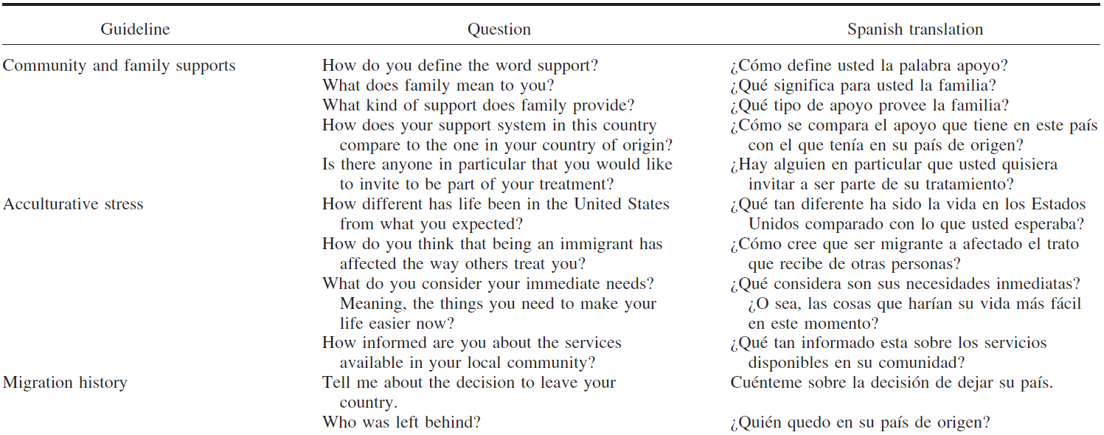
Expand your clinical interview…

Slide 48
Recommendations for culturally competent care

Slide 49
Get to know your patients…
Seeking to learn about our patients not based on assumptions
Notes:
HCP could seek to learn about the individual in the clinical arena, based not on assumptions (eg, lesbians and transgender men are not at risk of cervical cancer) but on their actual, lived history
A transgender person often must navigate both the health care and legal systems to change gender markers on their birth certificate, driver’s license, and passport, because some states or jurisdictions require medically certified docu- mentation confirming that an individual has undergone or is undergoing gender transition through cross-gender hormones and/or surgery

Slide 50
Intersectionality Perspective to care
Addressing intersectionality requires providers to confront own biases
(Wilson et al. 2019)
Notes:
Asking trans man about breast cancer
“An intersectional lens requires the clinician to confront his or her own biases, whether the presumptions are of commonality or of difference between the clinician and the patient.”
“Understanding clinician–patient interaction through an intersectional lens complicates the picture, challenges assumptions (sometimes yielding surprising information), and potentially clarifies issues that arise between the patient and the clinician”
Developing a critical self reflective lens that begins with the premise that race, class, and gender, and other axes of social identities are intertwined and mutually constiutitive. Such lens can help advance health disparities research by making the invisible visible

Slide 51
Cultural Humility
Cultural Humility
Multicultural orientation
Cultural Competency
Knowledge
Attitudes
Awareness
Skills
Lifelong learning
Holding institutions accountable
Recognizes power imbalance
Notes:
A personal lifelong commitment to self-evaluation and self-critique

Slide 52
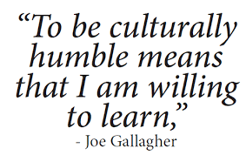
Cultural Humility during a clinical interview
A | Ask questions in a humble, safe manner
S | Seek self-awareness
S | Suspend judgement
E | Express kindness and compassion
S | Support a safe and welcoming environment
S | Start where the patient is at

Slide 53
Tools and Resources
Culturally Responsive Interventions
Intervention | Authors | Components
ESTEEM/EQuIP | Pachnakis et al., 2019 | Minority stress informed 10 session intervention
Proud and Empowered | Goldbach et al., 2021 | Intervention to improve mental health within SGM adolescents
LGBT adapted CBT for Depression | Ross et al., 2008 | CBT intervention informed by anti-oppression principles
LGBTQ expressive writing intervention | Pachankis et al., 2020 | Brief online intervention for LGBTQ young adults in high stigma and low resource context

Slide 54
Tools and Resources
Culturally Responsive Interview Guides
Interview Guide | Authors | Components
Cultural Formulation Interview | American Psychiatric Association (2013) | Assesses cultural factors affecting the clinical encounter
CAMINO | Silva et al., 2017 | Assesses aspects of the immigrant experience
A Guide for Conducting Cultural Assessments of Hispanic and Latino Clients | National Hispanic and Latino ATTC (2017) | Assesses acculturation and related stress factors
Clinical Ethnographic Interview | Arnault D. S., & Shimabukuro, S. (2012) | Assesses and gathers clinical information beyond verbal expression of symptoms

Slide 55
THANK You!
ANY QUESTIONS, COMMENTS, CONCERNS?
DAVID_ZELAYA@BROWN.EDU

