Slide 1
Bridging the gap between science and service…
Notes:
Welcome to CAAS rounds. For those of you who do not know me, I am Rosemarie Martin. I am here will my esteemed colleagues from the Addiction Technology Transfer Center or ATTC for short. CAAS rounds today will focus on How the ATTC bridges that gap from science to the SERVICE.
This year we are celebrating the 30th year of the ATTC. And September is national recovery month so this is perfect timing for sharing with you a bit about our history and impact in our region.
The New England ATTC at the Center for Alcohol and Addiction Studies of Brown University has been continuously funded since the ATTC network’s inception in 1993. Having a home in a world-class addiction research center, the New England ATTC fills a unique niche that sets us apart from other ATTCs in the country. Our role as technical assistance purveyors, paired with our home in a center dedicated to advancing science, makes us ideally suited to close the lengthy gap between the development of research-based addiction health services and their adoption to clinical practice.
How long does it take for new evidence-based finding to reach clinical practice?
Lack of efficient information infrastructure to better connect front-line professionals with the research community
difficulties in translating research into practice
inadequate system to help health care clinicians evaluate the strength of new study findings.
From the time you as a research scientist learn something significant from rigorous research and when the front line workforce changes their service delivery as a result is 17 years.

Slide 2
Motivating Outpatient Alcoholics to Quit Smoking
Smoking Cessation Treatment for Substance Abusers
Motivational Interviewing for Teen Smoking in the E.R.
Smoke-free Incentives for Pregnant Women and their Partners.
Motivational Interviewing with Adolescent Smoking
Adolescents, Alcohol, and Substance Abuse: Reaching Teens Through Brief Intervention.
Motivational interviewing for teen drinking and driving
Increasing alcoholics’ motivation to quit smoking
Motivational interviewing for ETOH+ in the E.R
Contingency Management and MET for Adolescent Smoking
Family Motivational Interviews for ETOH+ Teens in the ER
Incentives Plus Bupropion for Smoking in Schizophrenics
Smoking Versus Alternative Reinforcers in Adolescents
Contingent vouchers for smoking in substance abusers as adjunct to nicotine patch
Contingency Management for Drug Use in HIV+ Adults after Prison or Jail Release
Notes:
I went back and looked at the titles of grants funded 20 years ago. I am going to read these out and please make note of themes.

Slide 3
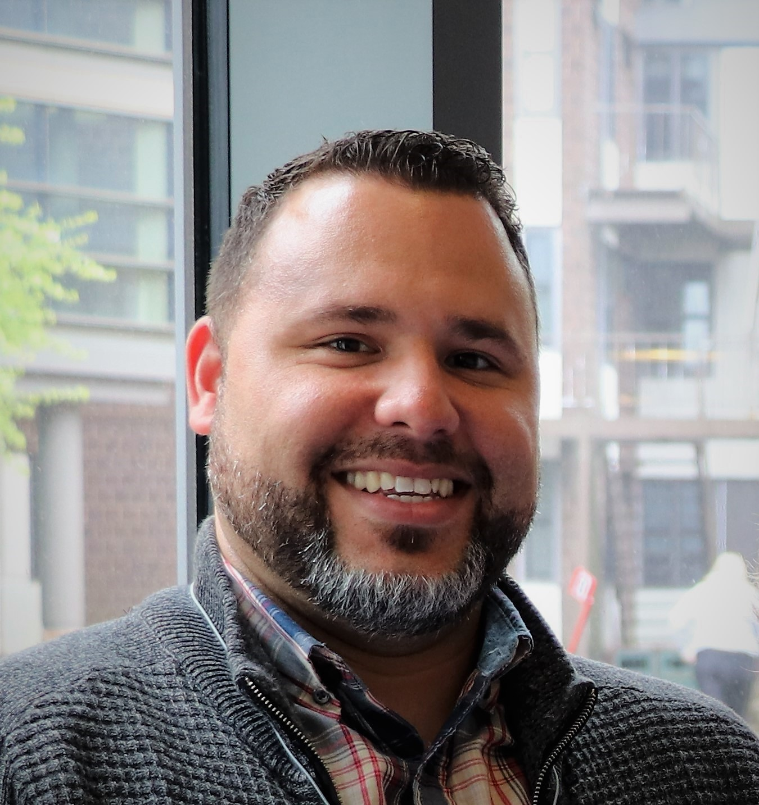
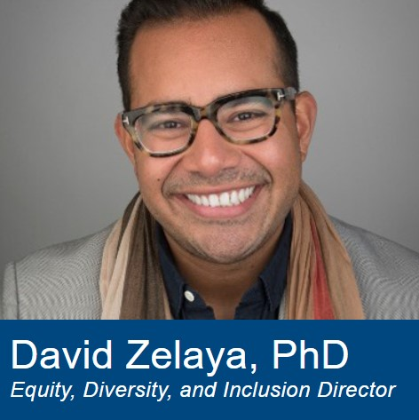
Meet the Team
Rosemarie Martin,
Project Director
Sara Becker,
Co-Director
Ray Sanchez,
App/Tech Coordinator
Denise Bayles,
Training Coordinator
Haner Hernandez
Senior Consultant
Mika Salas,
Operations Coordinator
David Zelaya,
Equity, Diversity, and Inclusion Director
Tonya Tavares,
Tech Transfer Specialist
Kelli Scott,
Evaluation Director
Madeleine Kemo,
Research Assistant
Notes:
We also have two PhD students that work with us Amelia Bailey, and Siena Napolian that assist with our harm reduction and recovery science initiatives.

Slide 4
Notes:
As a visual for understanding where SAMHSA sits within Department of Health and Human Services – SAMHSA is Division with HHS at the same level as NIH which most folks here are most familiar.

Slide 5
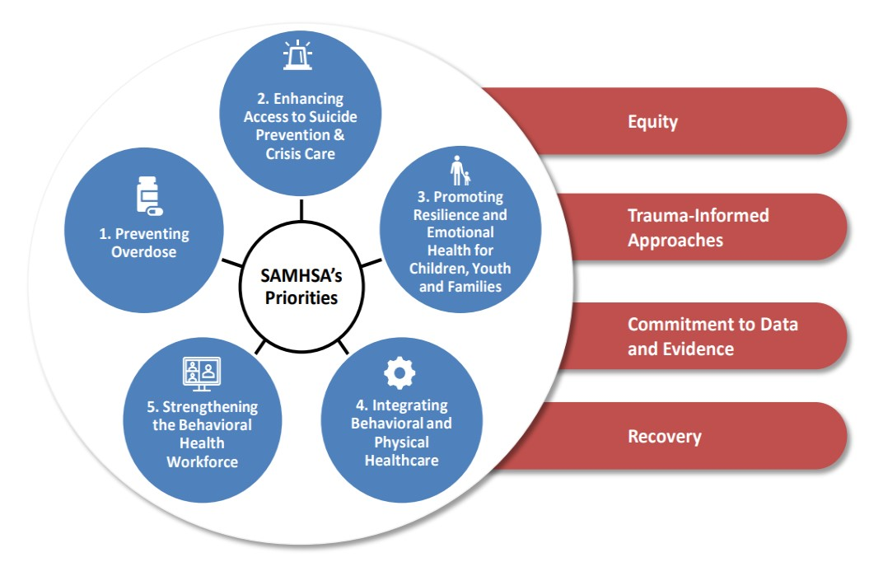
Notes:
. Our work at the ATTC is guided by SAMSHAs priorities and principles. The Strategic Plan integrates four overarching guiding principles across all policies and programs to support SAMHSA in achieving its mission and vision. The four principles shown in the red bars on the right and they are equity, trauma informed approaches, recovery and commitment to data and evidence.
To achieve its mission, SAMHSA has identified five priority areas to better meet the behavioral health needs of individuals, communities, and service providers.
The five priority areas are:
Preventing Substance Use and Overdose
Enhancing Access to Suicide Prevention and Mental Health Services
Promoting Resilience and Emotional Health for Children, Youth and Families
Integrating Behavioral and Physical Health Care
Strengthening the Behavioral Health Workforce
I am going to start by playing a short video that our National Coordinating Office created that provides a great overview of the ATTC national network.

Slide 6
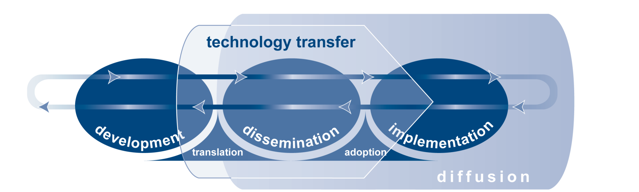
Technology Transfer
Notes:
Technology transfer is best understood within the broader context of diffusion. The ATTC Technology Transfer Model) illustrates the continuum of the diffusion of an innovation from creation through implementation. During development, the innovation is designed and evaluated. [Next slide] In translation, the essential elements and relevance of the innovation are explained and packaged to facilitate spread. In dissemination, awareness is promoted with the goal of encouraging the adoption process. [Next slide] Lastly, in implementation, the innovation is incorporated into routine practice in real-world settings. Bi-directional communication is a critical component throughout the continuum, represented by the feedback loop. Highlighted in the model is technology transfer, a multidimensional process which intentionally promotes the use of an innovation. It begins during development, continues through dissemination, and extends into early implementation. This process requires multiple stakeholders and resources, and involves translation and adoption activities. Technology transfer accelerates diffusion of innovations through such strategies as adult learning techniques, social marketing, and organizational development.
the ATTCs have focused in this area of the model, providing numerous trainings to large numbers of participants.

Slide 7
New England Addiction Technology Transfer Center (ATTC)
Accelerate the uptake of evidence-based culturally appropriate practices
Improve awareness, knowledge, and skills of the workforce
Foster regional and national alliances
Notes:
The vision of the ATTC Network is to unify science, education and service to transform lives through evidence-based and promising treatment and recovery practices in a recovery-oriented system of care.
Our mission is best summed up with three major objectives.
Accelerate the adoption and implementation of evidence‐based and promising addiction treatment and recovery-oriented practices and services
Heighten the awareness, knowledge, and skills of the workforce that addresses the needs of people with substance use and/or other behavioral health disorders; and
Foster regional and national alliances among culturally diverse practitioners, researchers, policy makers, funders, and the recovery community.

Slide 8
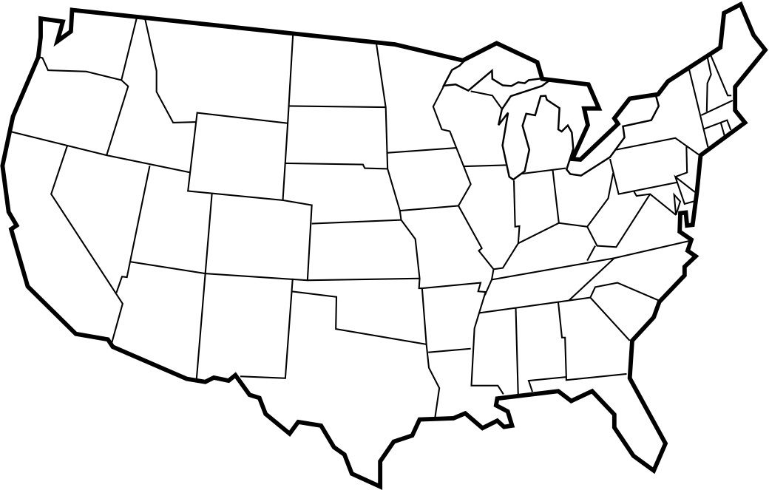
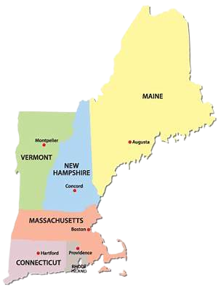
How we work with and leverage partners

Slide 9
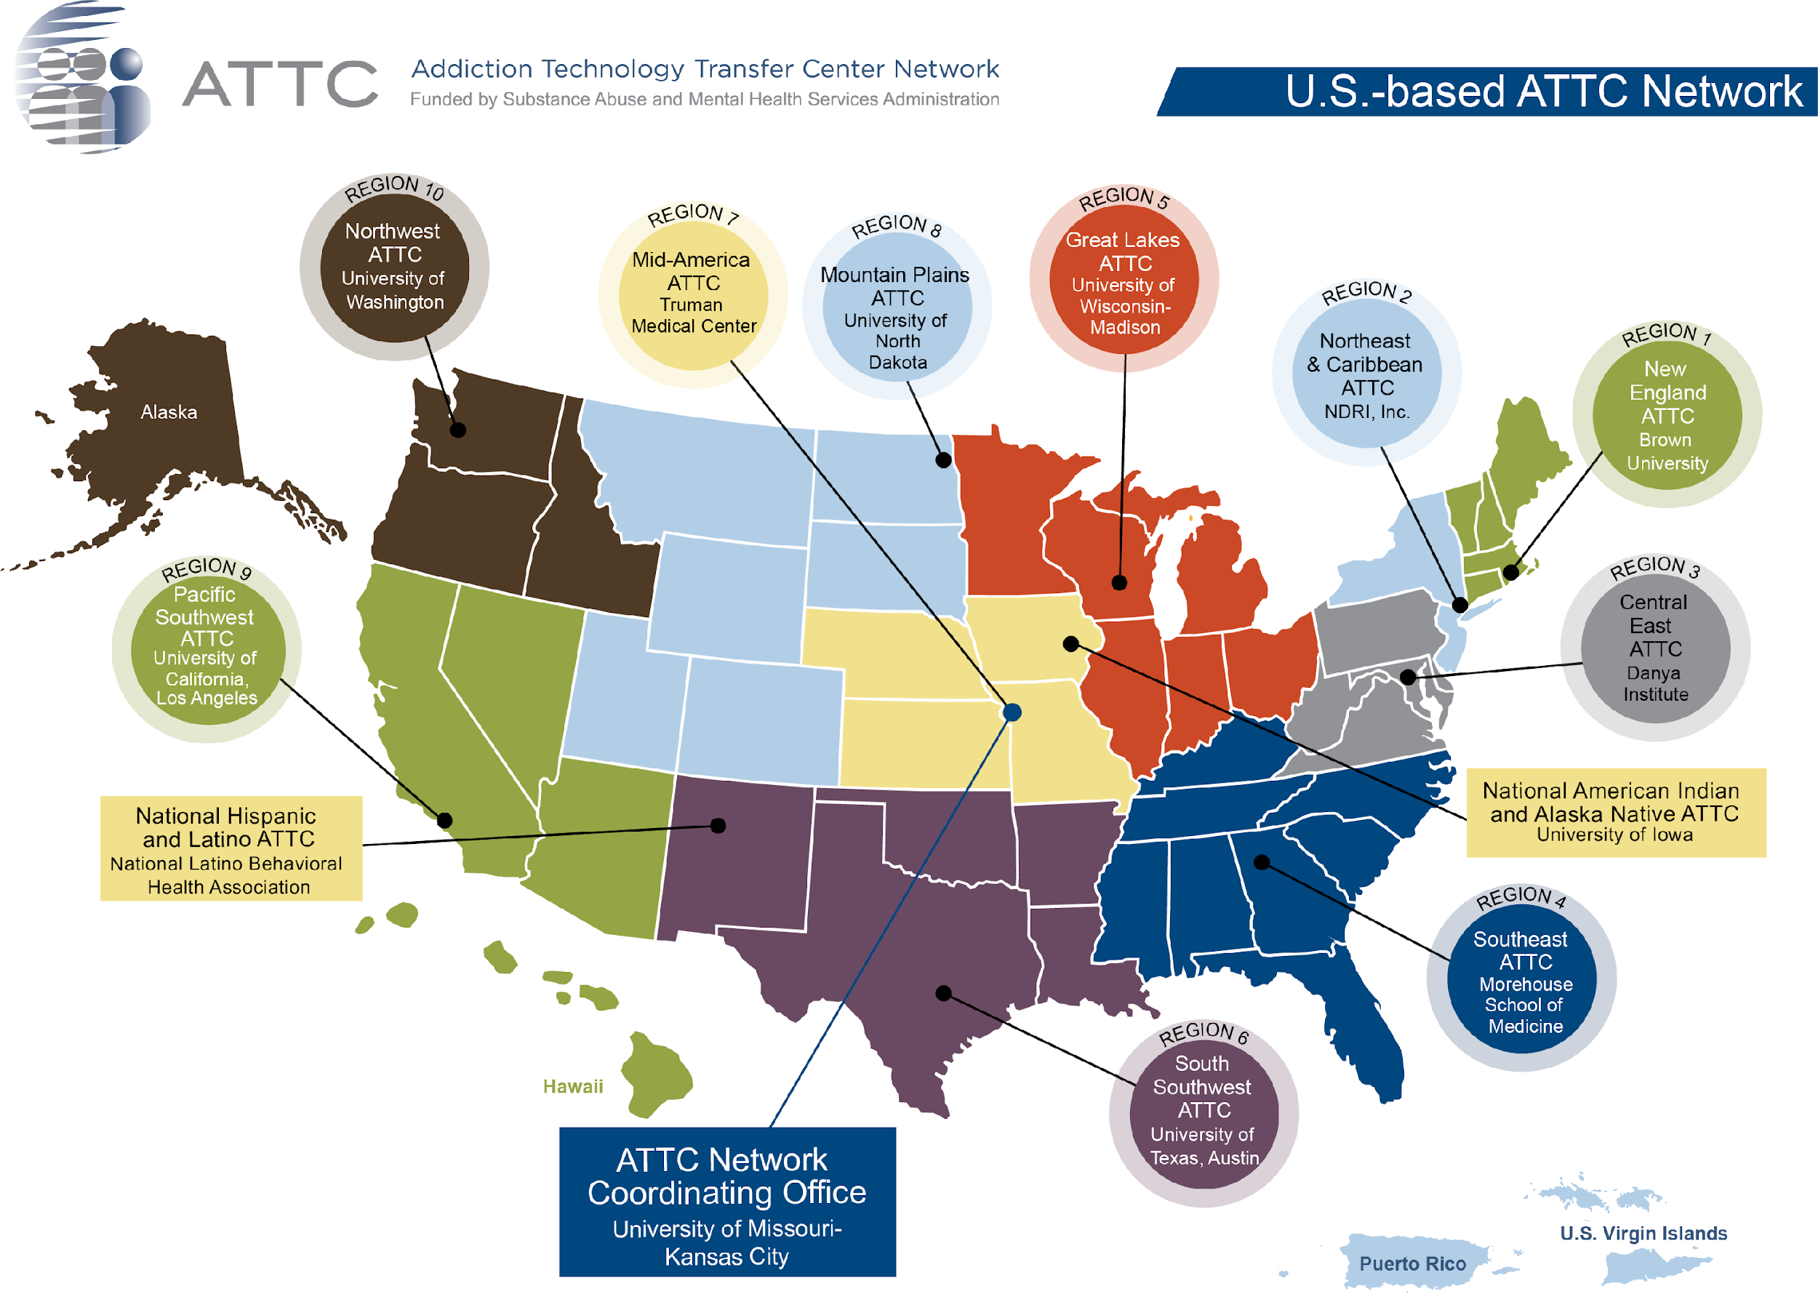
Notes:
The New England ATTC is one of 10 regional ATTCs funded by the Substance Abuse and Mental Health Services Administration, which are tightly coordinated by a National Coordinating Office. One of the great things about the ATTC network is that if you reach out to a regional ATTC for support, you can form longstanding, meaningful regional connections while tapping into a national network of subject matter expertise.
Fun fact - the ATTC network is SAMHSA’s longest running training and technical assistance initiative, and our ATTC has been based at Brown University since the network’s inception.
The ATTC network has been so effective that within the past 7 years, SAMHSA decided to replicate it and form networks focused on prevention and mental health. This morning you will also be hearing from members of the ATTC.

Slide 10
How we work with and leverage partners
Federal Level
Notes:
Stimulant curriculum
Pictures from SAMHSA centers for excellence
https://www.samhsa.gov/practitioner-training
ORN – replace 988

Slide 11
How we work with and leverage partners
Regional Level
Notes:
Recovery rallies

Slide 12
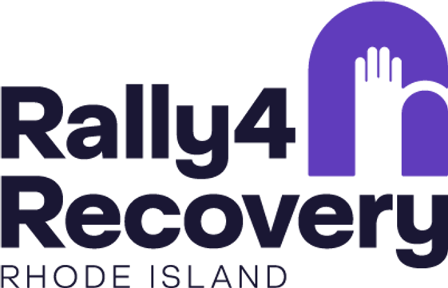
How we work with and leverage partners
State Level
Notes:
single state agency
The Single State Agency (SSA) is the lead agency in each State responsible for managing federal funds dedicated to addressing substance use prevention, treatment, and recovery. SSAs set priorities for each state and delveop policy managing their state’s prevention, treatment, and recovery system.
This resource explores seven key responsibilities of the SSA:
Managing the Substance Abuse Prevention and Treatment Block Grant;
Managing Opioid-Specific Grants to States;
Promoting Effectiveness Through Planning, Oversight, And Accountability;
Reporting Data;
Promoting and Ensuring Quality;
Encouraging Coordination Across State Government; and
Working with the Provider Community.
– Topic focused and location focused-
Stand alone
Popular trainings from our brochure.
List 8-10 of them
Pictures of the 6 SSA topics
RI BHDDH
Logos from state level
RIDOH, Connecticut DOC, HETI Maine,

Slide 13
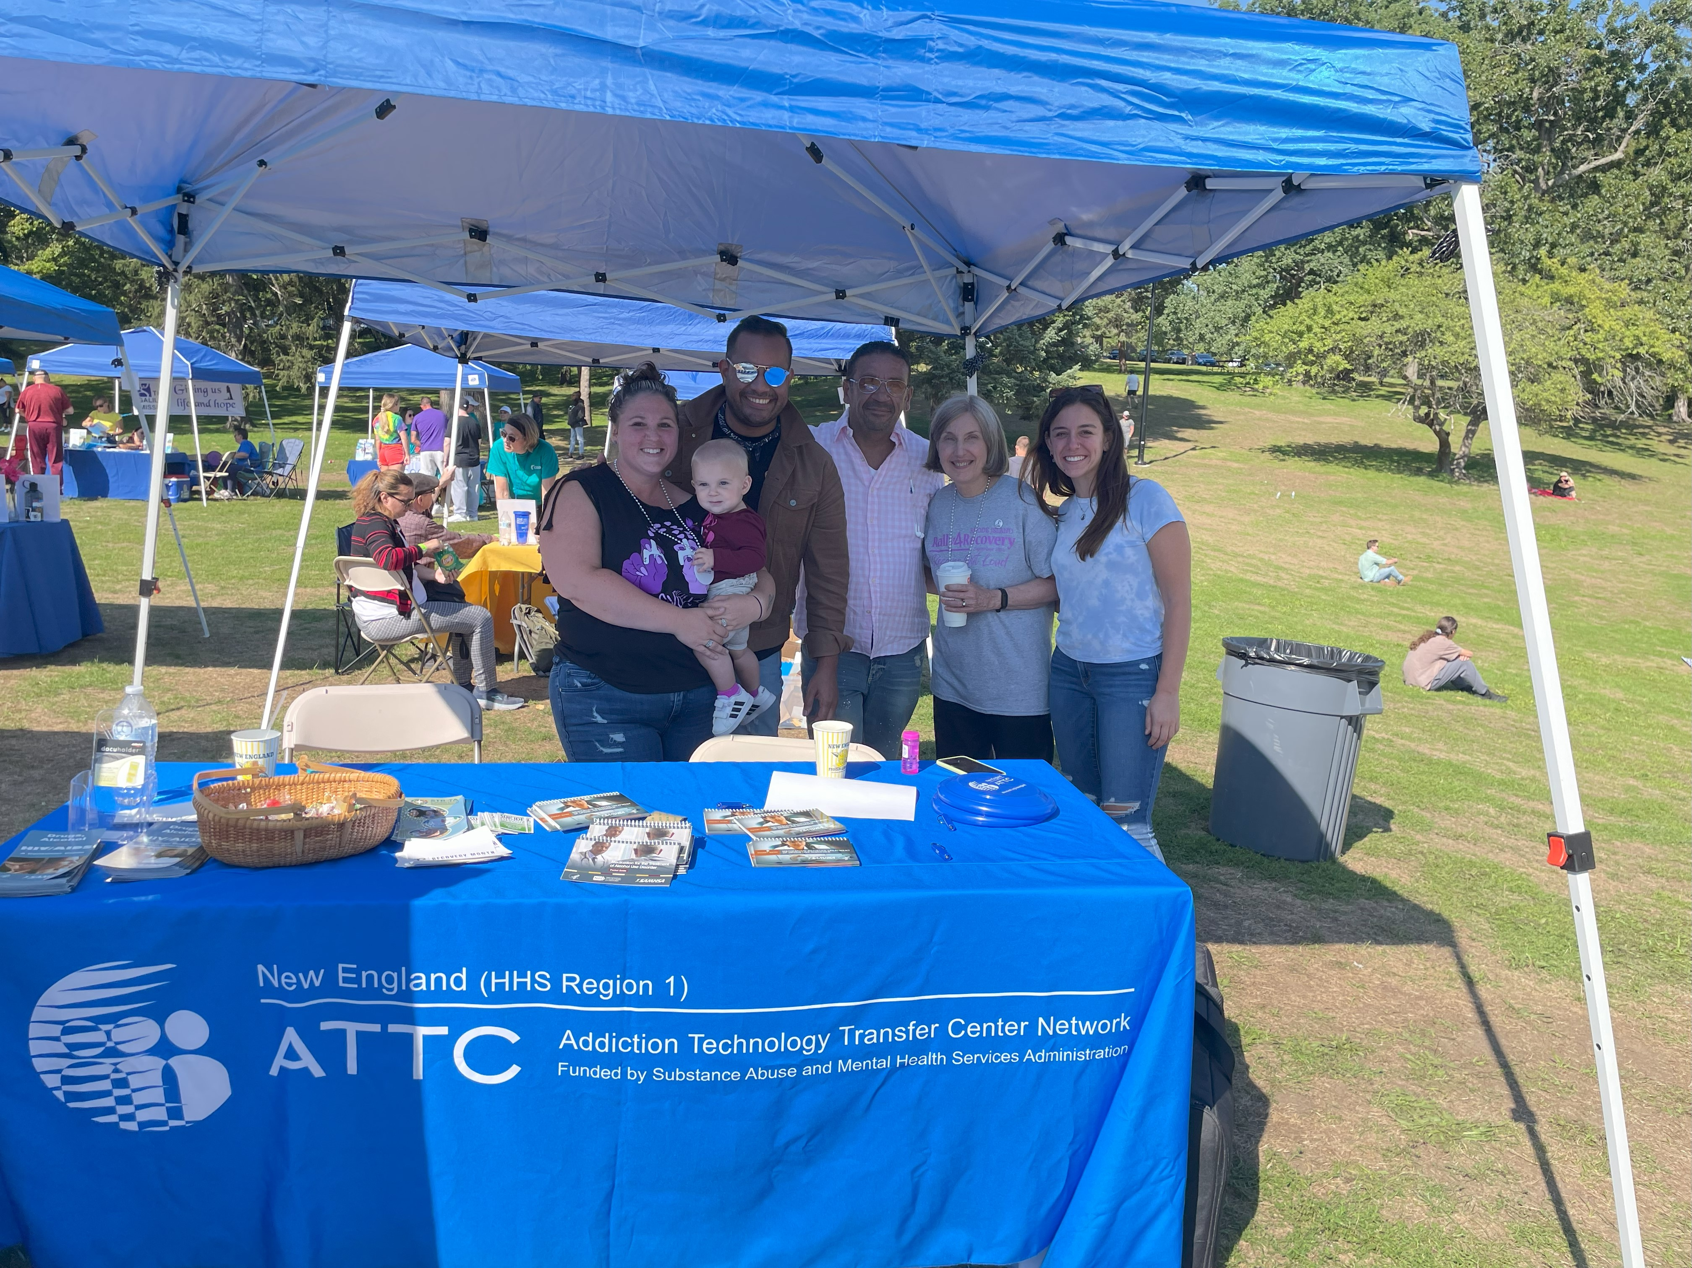
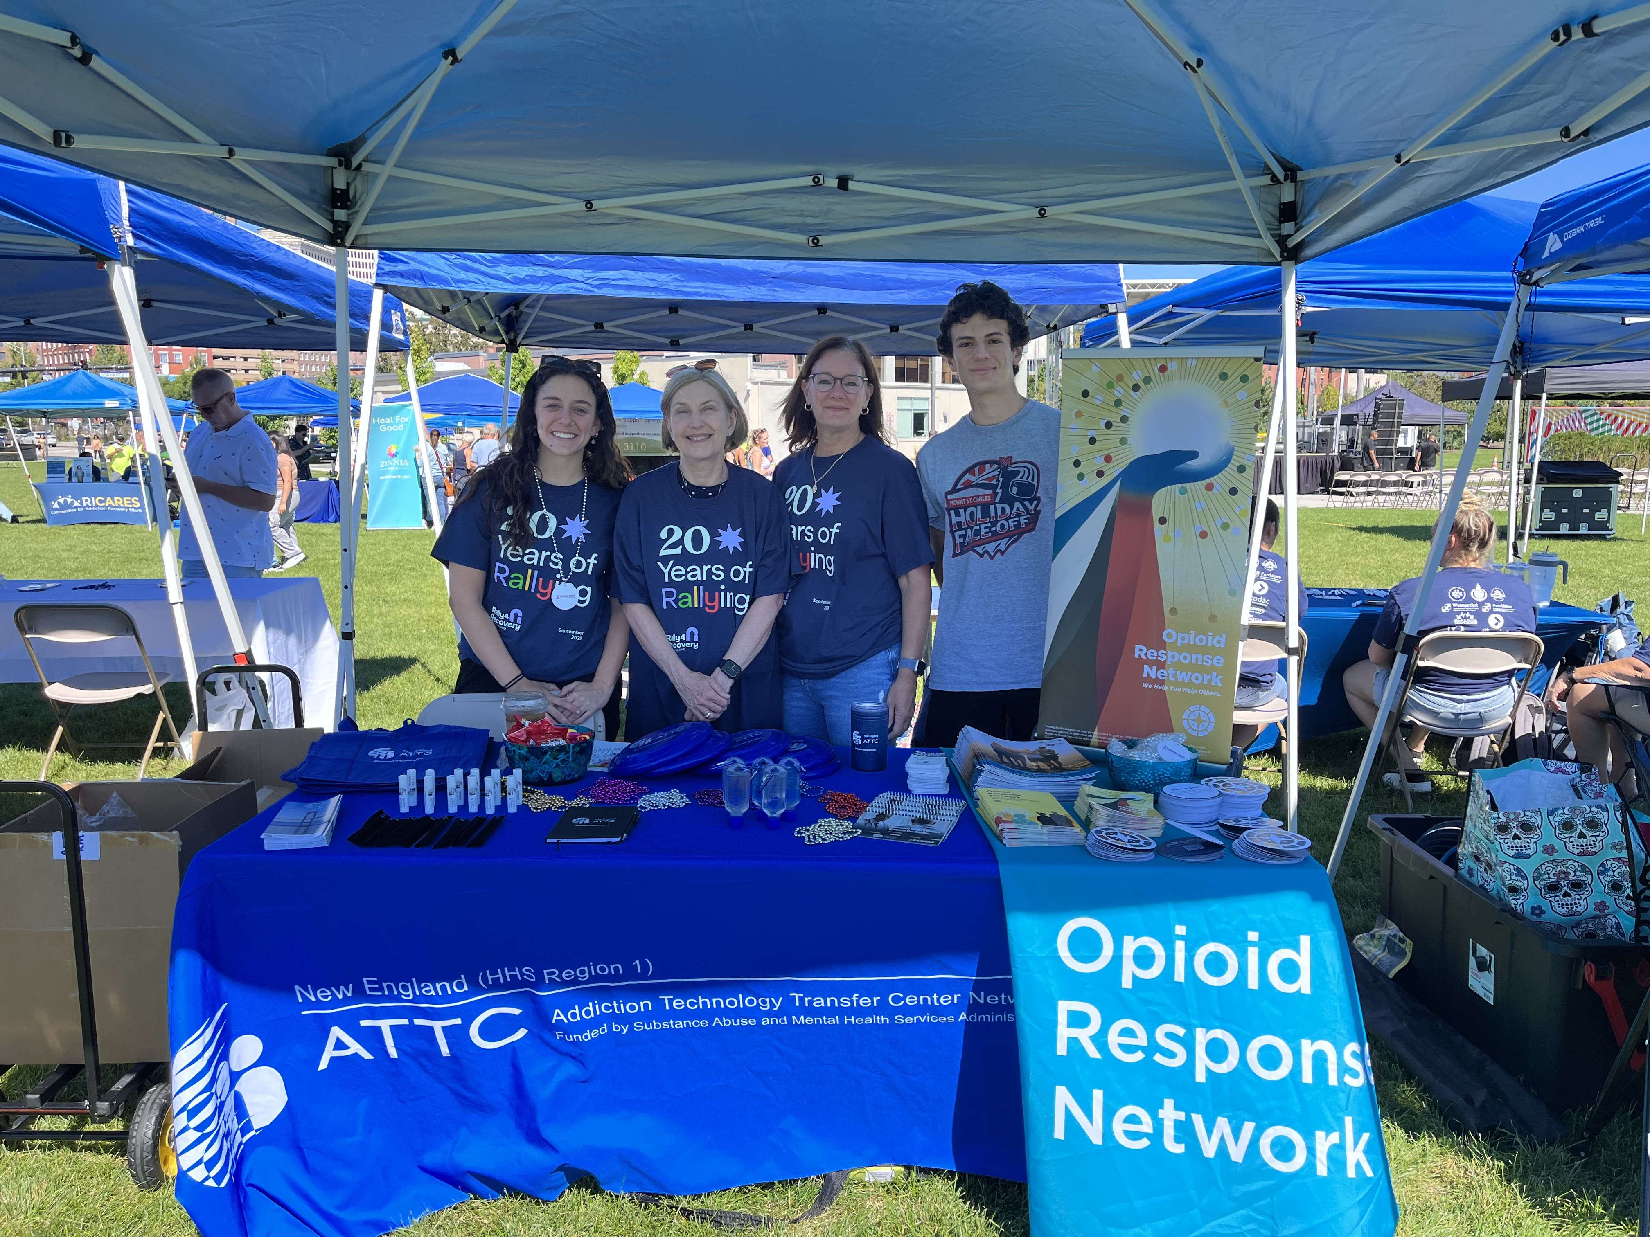
Rhode Island Rally 2022
Rhode Island Rally 2023
Notes:
ATTC is proud to support the Recovery Month Celebration events throughout New England. All of these events are open to the public and we encourage you to attend and share these events widely.

Slide 14
Our Audience
Practitioners
Students
Systems
State agencies
Notes:
Practitioners who provide services to people who have, or who are at risk of developing, substance use disorders, including those in:
Specialty SUD treatment
Primary healthcare
Criminal justice
Child welfare
Faith community
Peer recovery support
Students learning to provide services to people who have, or who are at risk of developing, substance use disorders, including those in:
Specialist addiction studies programs
General behavioral health programs (social work, counseling)
Medical/health sciences programs (nursing, pharmacy, dentistry, medicine)
Public health programs
Systems
State Treatment Systems
Criminal Justice
Primary Care
Colleges, Universities
Child Welfare
HHS Training and TA Centers
Hospitals

Slide 15
How we do what we do
Needs assessments with each state
Develop workplan with SAMHSA Director
ATTC Advisory Board
Board Members
Workgroups at national and regional levels
Direct outreach to stakeholders (exhibiting)
Sponsorship and support of events
Direct TA
Notes:
Needs assessments with each state
ATTC Advisory Board - The Mountain Plains ATTC Advisory Board meets semi-annually to build and maintain collaborative relationships; advise the Mountain Plains on workforce interests, needs, and capacities to coordinate regional training/TA services
We are bringing together partners from all 5 states in our region to discuss issues and initiatives around addiction treatment and recovery. The 2-day, in person event will provide ample networking opportunities to connect and discuss issues on a variety of different topics that include but are not limited to, culturally appropriates services of our region, workforce issues, current projects, and more.
single state agency
The Single State Agency (SSA) is the lead agency in each State responsible for managing federal funds dedicated to addressing substance use prevention, treatment, and recovery. SSAs set priorities for each state and delveop policy managing their state’s prevention, treatment, and recovery system.
This resource explores seven key responsibilities of the SSA:
Managing the Substance Abuse Prevention and Treatment Block Grant;
Managing Opioid-Specific Grants to States;
Promoting Effectiveness Through Planning, Oversight, And Accountability;
Reporting Data;
Promoting and Ensuring Quality;
Encouraging Coordination Across State Government; and
Working with the Provider Community.
we held a series of one-on-one meetings with each state to learn about the state’s most pressing training and technical assistance needs
In conjunction with the Region 1 SAMHSA Administrator, we create a workplan to address regional priorities
All of this is guided by our Advisory Board. We bring together partners from all 6 states in our region to discuss issues and initiatives around addiction treatment and recovery. representatives from all six SSA offices, representatives from the treatment and recovery communities, and patient advocates participated in our semi-annual interactive meetings.
Board Members
Workgroups at national and regional levels
Direct outreach to stakeholders (exhibiting)
Sponsorship and support of events
Direct TA
What are the forms of technical assistance
work in many ways to customize and tailor the trainings to the needs of our region

Slide 16
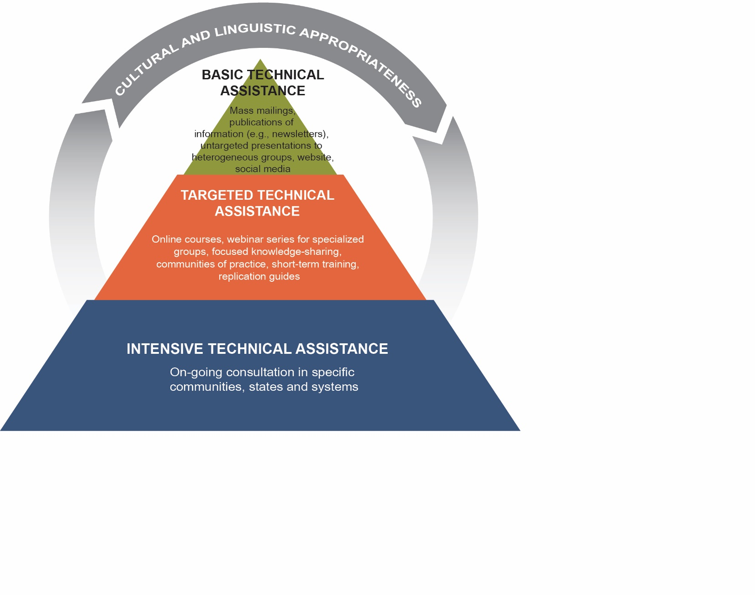
Technical Assistance Pyramid
Regional newsletter, national blog, national self-paced courses, webinars and conferences
Menu of customized training and targeted TA on evidence-based treatment, harm reduction and recovery practices
(new national content on stimulants, compassion fatigue, health equity)
Leadership Development Initiative, Opioid Response Network, Motivational Interviewing, Health Equity Assessments
Notes:
Madi: Our work in pursuit of those three objectives is guided by our Technical Assistance Pyramid. This pyramid shows that the work of the ATTC network ranges from basic to intensive, with an overarching theme of grounding in cultural and linguistic appropriateness. The size of each layer of the pyramid denotes the level of time commitment involved.
Let me take a moment to walk you through this pyramid (start to click animation).
At the top of the pyramid, we offer basic TA – these are supports that we share with large groups that are generally designed to build awareness and knowledge. Examples are our regional newsletter, a national blog, self-paced courses, and webinars and major conferences that we host. If you engage with us in basic TA, this will not require much time investment at all.
In the middle of the pyramid, we offer targeted TA – these are customized training series that are generally designed to build provider skills delivering a specific service. Targeted TA often includes multiple points of contact, such as in communities of practice, learning collaboratives and other ongoing training series. If you engage with us in targeted TA, this is a moderate time commitment.
At the bottom of the pyramid, we offer intensive TA – this is ongoing consultation that is designed to help an individual, organization or health care system make meaningful, sustainable change. Our leadership development series is one of our flagship intensive TA offerings! When you engage with us in intensive TA, it is a much more significant time commitment, but we believe the payoff is well worth it. For this reason, our ATTC has a national reputation for investing in far more intensive TA than our peers throughout the country – because we believe making sustainable change requires an intensive commitment on your part and on our own!

Slide 17
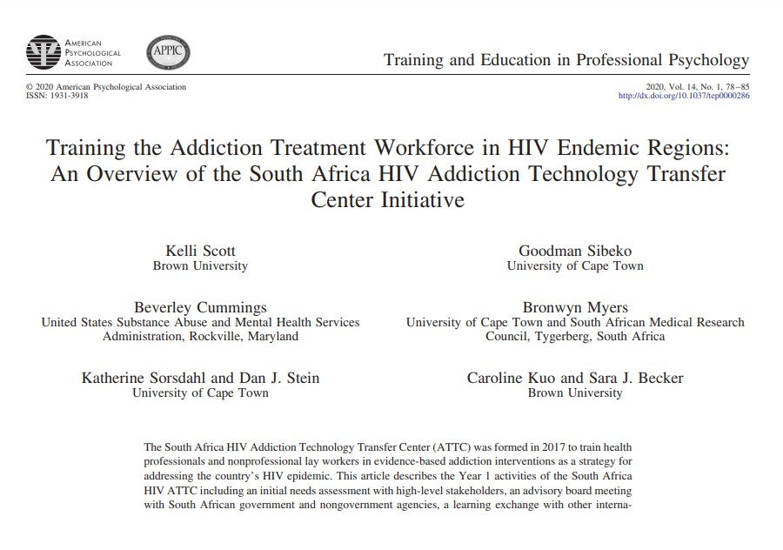
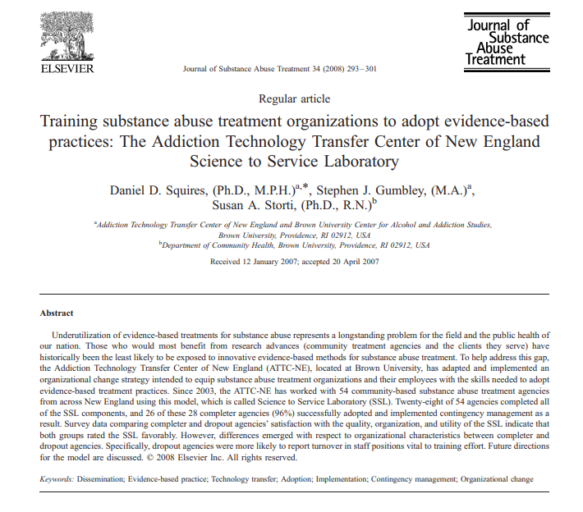
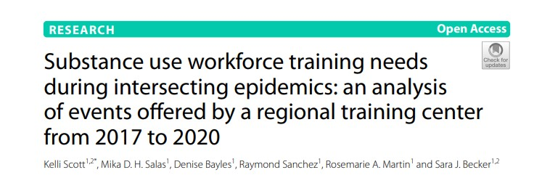
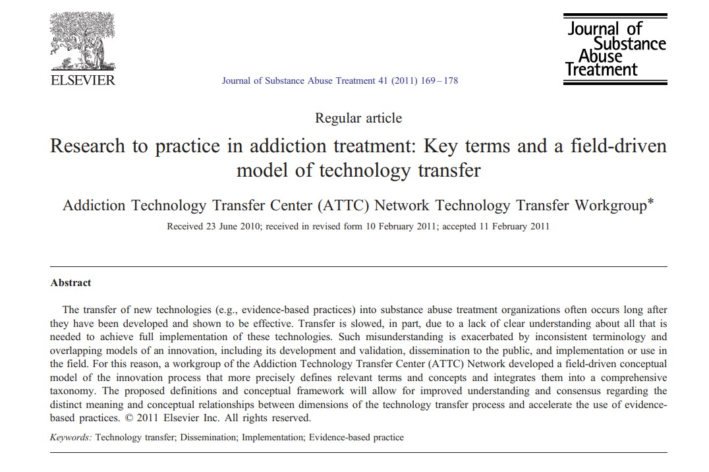
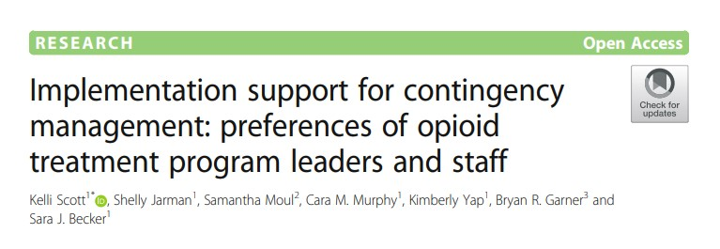
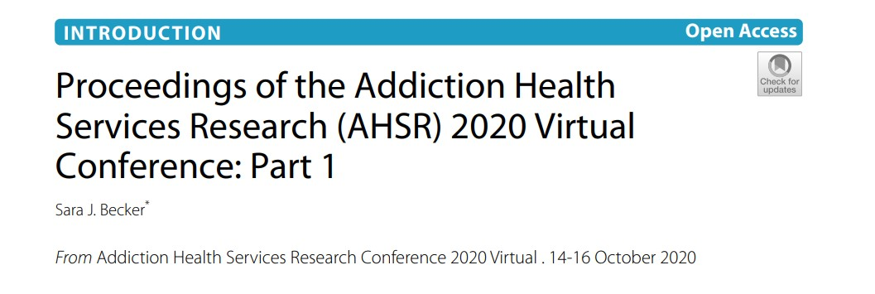
Evidence–Based Training and Practice–Based Evidence
Notes:
Pictures of paper covers instead
As a part of our mission to provide evidence-based trainings we also engage in research
Here are some of our previous publications

Slide 18
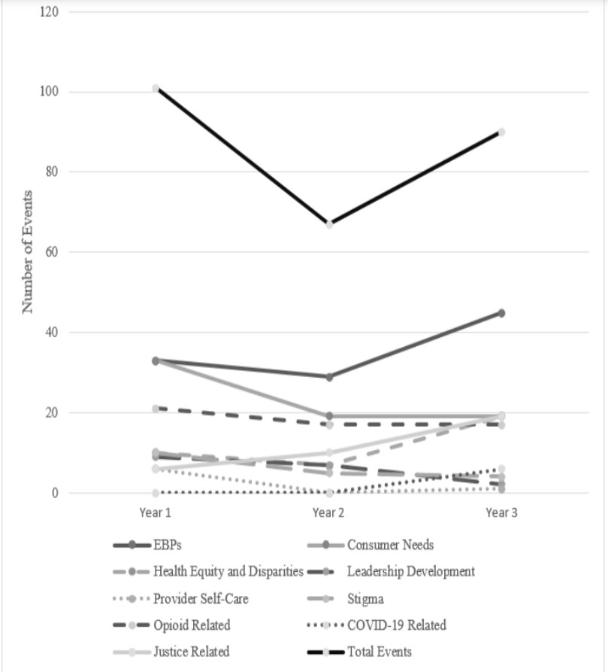
Trends in Training
October 2017 - September 2020
258 events
10,143 event attendees
Notes:
Kelli’s paper
https://www.ncbi.nlm.nih.gov/pmc/articles/PMC8509100/
Show figure 2, attendees
Analyzed nationwide- highlight that we are nationally known for doing a lot of intensive TA
3 fiscal years

Slide 19
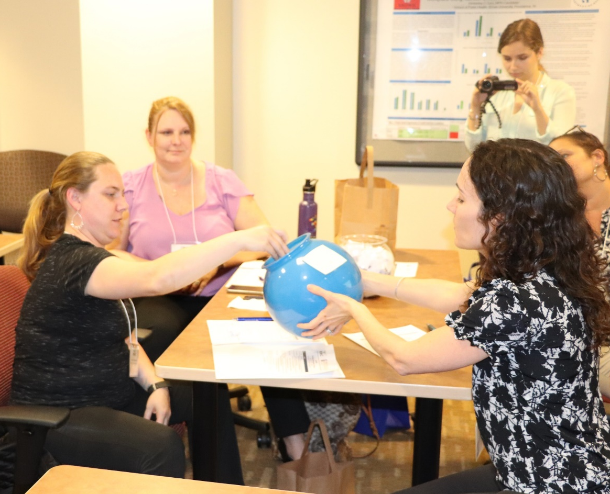
Examples of Intensive TA
Contingency Management
Motivational Interviewing
“Bob has a knack for helping people learn by saying just the right thing, in just the right way. His knowledge of Motivational Interviewing is deep and wide.”
“This was GREAT training. Stephen was a captivating, humble, open-minded, inspiring, ‘intelligent’ teacher!”
Notes:
Of the 10 ATTCs across the country, our center has been praised for our intensive TA
Emphasis on evidence based
Pictures of CM trainings from recent advisory board- on the drive
Bob Jope and HETI Maine
Check for titles of popular Intensive TA

Slide 20
Motivational Interviewing (MI): Intensive and Targeted TA Initiatives
Bob Jope – MI Trainer Extraordinaire!
Bob Jope is our subject matter expert providing the following MI targeted and intensive TA in the New England Region:
Overview of Motivational Interviewing
Basic, Intermediate, and Advanced Motivational Interviewing
Motivational Interviewing in Groups
Motivational Interviewing in Supervision
Teaching Motivational Interviewing
Bob has also established a “bank” of coding slots available to those in the region who don’t otherwise have support in their organization for sustained support for MI fidelity.
This intensive TA involves participants submitting a tape of their MI sessions for coding and individual feedback.

Slide 21
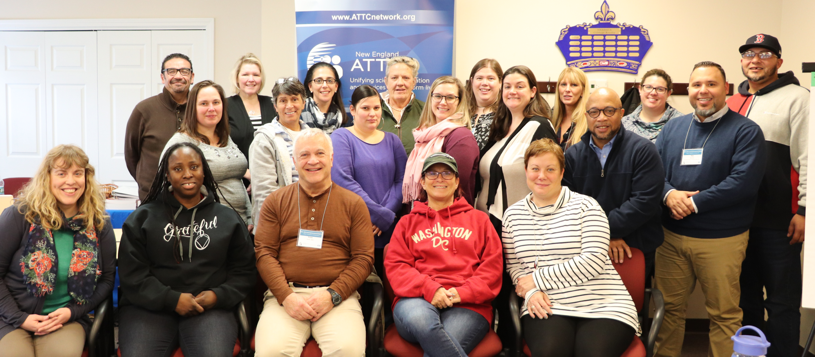
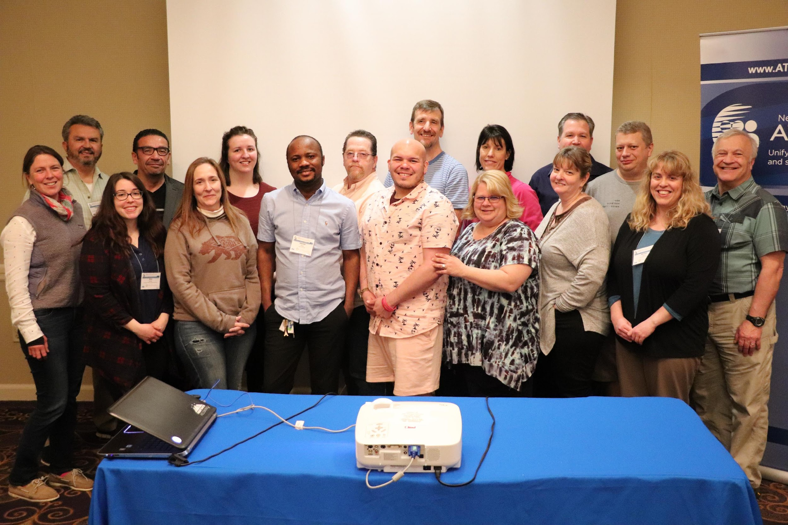
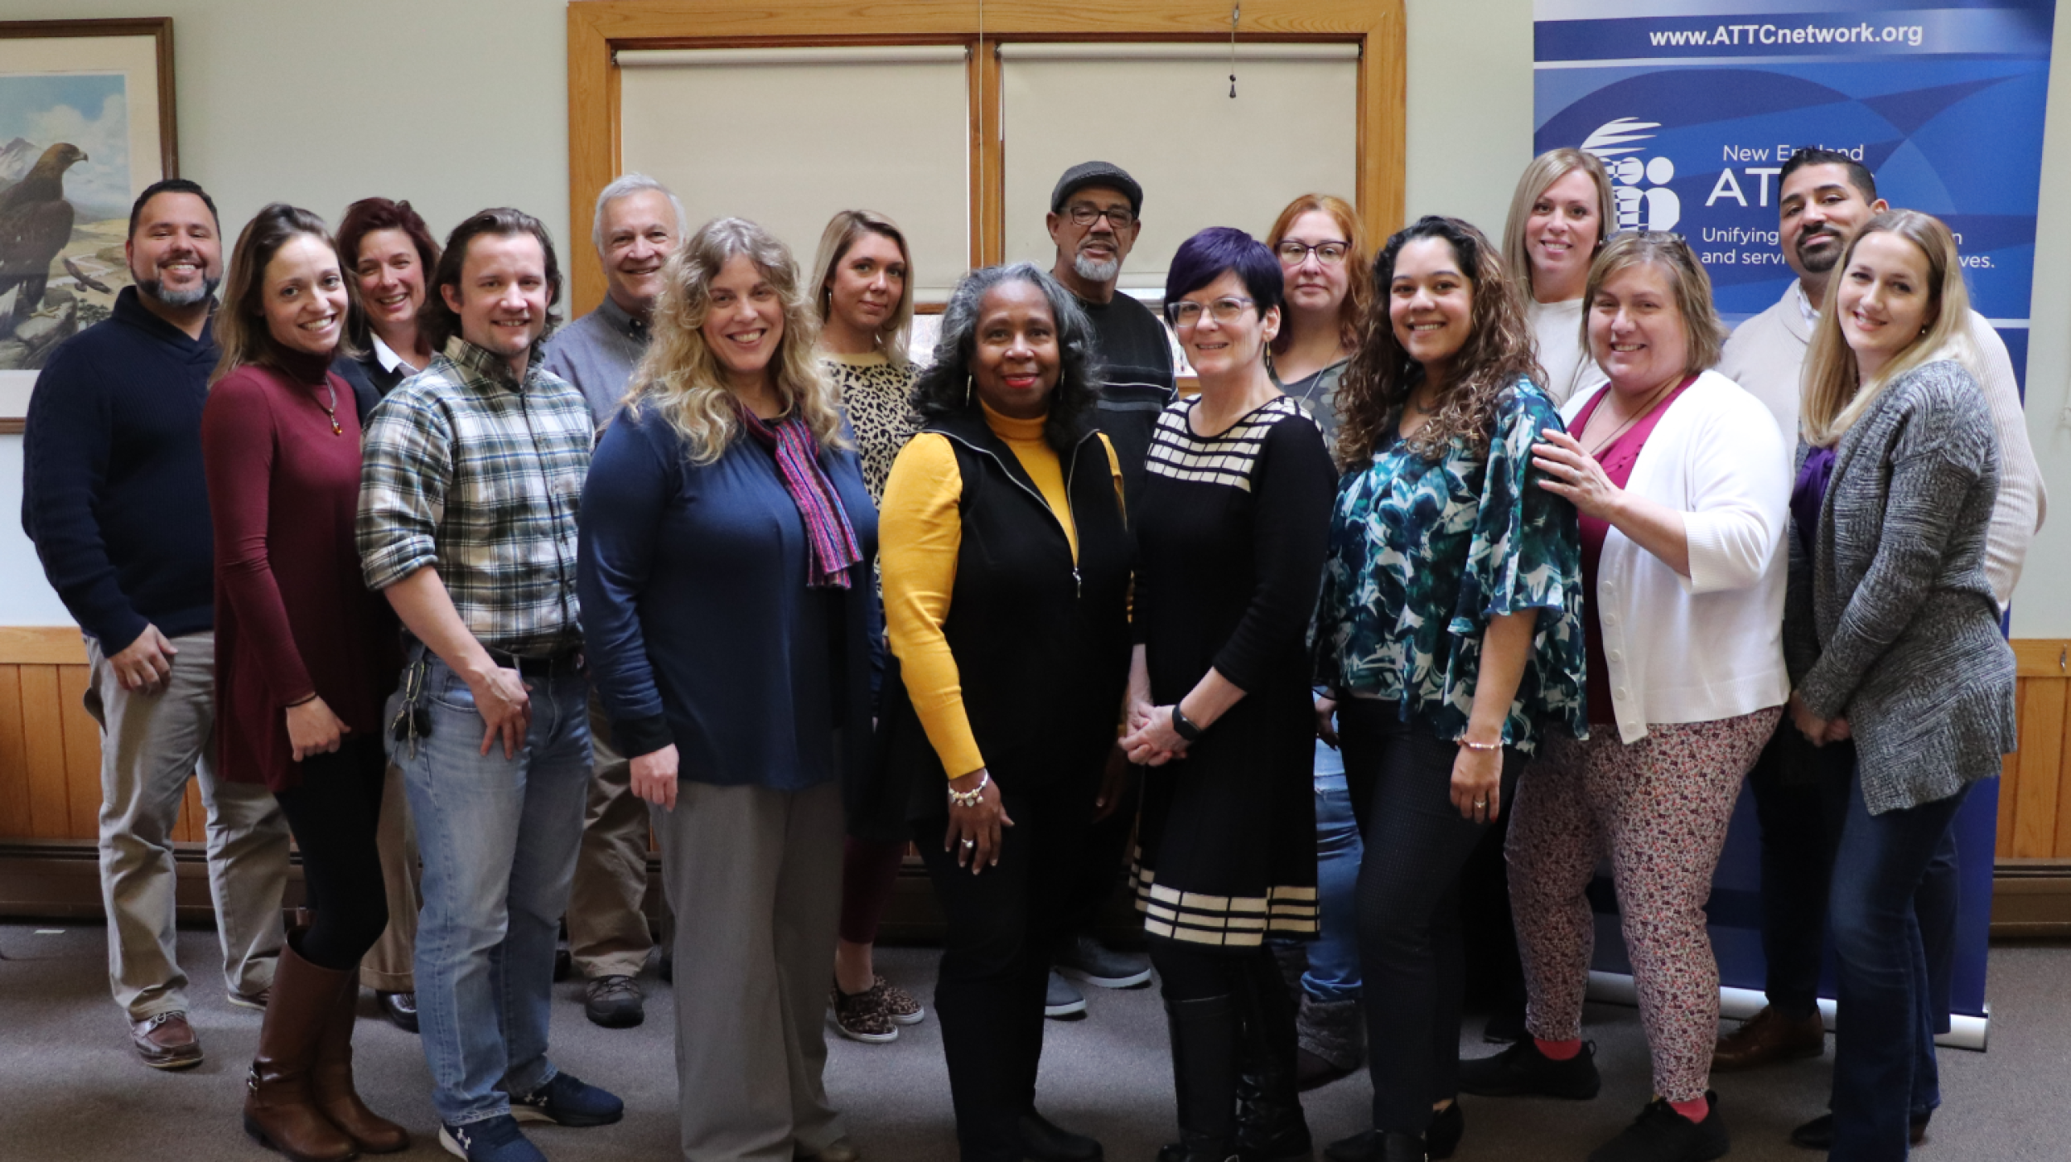
Notes:
Our flagship
Cohort 9 in the spring was the largest cohort to date
We will be hosting our first annual alumni event in october

Slide 22
SAMSHA’s National Outcome Measures Service Tool: Collecting Sexual Orientation, Gender Identity, and Race/Ethnicity Demographic Information in a Culturally Humble and Sensitive Approach
David G. Zelaya, Ph.D. (he/him/el)
Equity, Diversity, and Inclusion Director
April 13th, 2023
Notes:
Place your title on this first slide and include any subtitle.
DO NOT CHANGE THE FORMAT OF THIS TEMPLATE. If you are creating ATTC-branded slides, you must use this template. If you move around boxes, make sure to check the reading order. If you widen any boxes they must not overlap any other box.
IF YOU ADD ANY GRAPHICS, you will need to add ALT TEXT and check READING ORDER.
(If the notes on ALT TEXT and READING ORDER do not make sense to you, please let the ATTC National Coordinating Office know to help with remediation.)

Slide 23
Agenda
Sexual Orientation and Gender Diversity Language
Cultural Humility
Q&A/ Experiential Activity

Slide 24
Cultural Humility
Multicultural orientation
Cultural Competency
Knowledge
Attitudes
Awareness
Skills
Lifelong learning
Holding institutions accountable
Recognizes power imbalance
(Mosher et al., 2017)

Slide 25
Get to know your patients…
Seeking to learn about our patients not based on assumptions
Notes:
HCP could seek to learn about the individual in the clinical arena, based not on assumptions (eg, lesbians and transgender men are not at risk of cervical cancer) but on their actual, lived history
A transgender person often must navigate both the health care and legal systems to change gender markers on their birth certificate, driver’s license, and passport, because some states or jurisdictions require medically certified docu- mentation confirming that an individual has undergone or is undergoing gender transition through cross-gender hormones and/or surgery

Slide 27
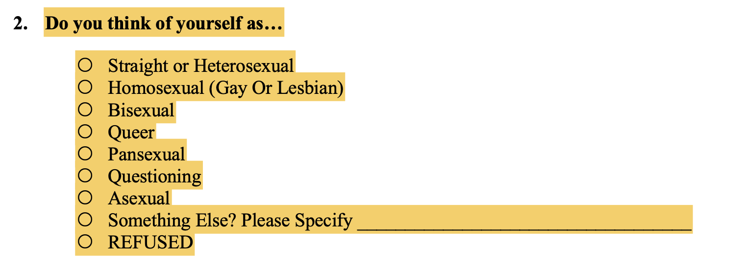
Straight/heterosexual is first (implies heterosexuality is the norm and default)

Slide 28
Tips for creating an inclusive environment…
Share your pronouns with everyone
Incorporate inclusive language (e.g., ‘hi everyone’ vs. ‘hey guys’; ‘parent/legal guardian’ vs ‘mom and dad’)
Know general definitions when talking about gender identity and sexual orientation

Slide 29
Tips for creating an inclusive environment…
Include diverse LGBTQ+ themed posters
Don't assume and seek further education
You will make mistakes and its ok!

Slide 30
Incorporating an Intersectionality Framework to Understand the Impact of Racism and Heterosexism on the Health Disparities Encountered by LGBTQ+ People of Color
David G. Zelaya, Ph.D.
Assistant Professor
Brown University School of Public Health
New England ATTC
Equity, Diversity, and Inclusion Director

Slide 31
Agenda
Introduction
Terminology
Intersectionality
Minority stress
Stressors & Health Disparities
Cultural humility
Evidence-Based Interventions (or lack thereof)

Slide 32
The 4 I’s of Oppression
Idea that one group is better than other; social root of inequality
How ideology is manifested within systems: legal rights, medical, media, education
Health Disparities
Ideological
Institutional
Interpersonal
Internalized
Mechanism through which people play out discrimination on each other
Internalized narratives of inferiority
(Jones, 2002)

Slide 33
Intersectional Invisibility
Intersectional invisibility
Androcentrism
Ethnocentrism
Heterocentrism
Ciscentrism
Notes:
what is it?
less protoyptical identities, further pushed to the margins
more people experience different types of oppression, such as cultural imperialism, marginiazaltion, violence, exclusion. consdier your own patients? implications for research? evidence based?

Slide 34
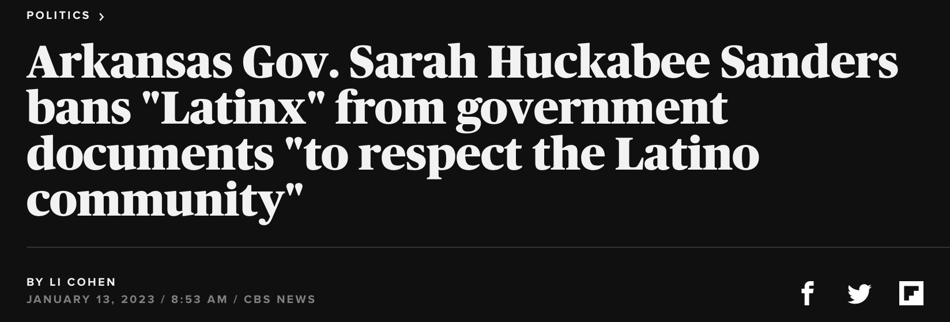
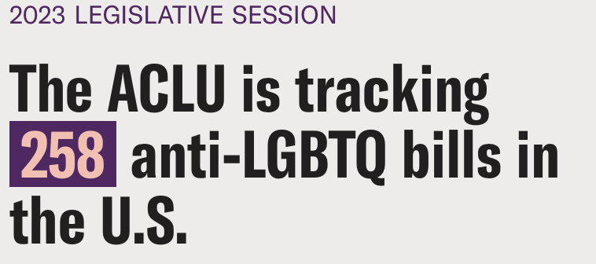
Current climate (proximal/distal stressors)…

Slide 35
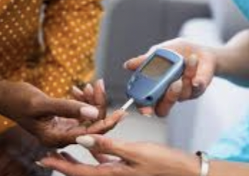
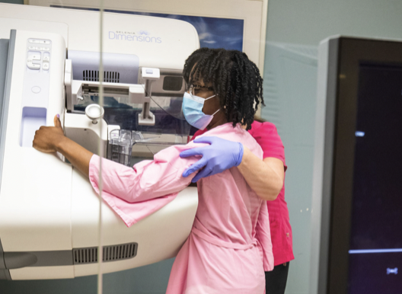
LGBTQ+ PoC Health Disparities

Slide 36
Health Disparities
Health Difference ≠ Health Disparity
Race ≠ Health Disparity
Sexual Orientation ≠ Health Disparity
Gender Identity ≠ Health Disparity
Racism = Health Disparities
Heterosexism = Health Disparities
Cis-sexism = Health Disparities
Systems of Oppression
Minority stress has been theorized to exacerbate these disparities and risk
Notes:
add transitions

Slide 37
Intersectional Perspective to care
Intersectional lens can help decrease health disparities by making the invisible visible
Addressing intersectionality requires providers to confront own biases
Notes:
Asking trans man about breast cancer
“An intersectional lens requires the clinician to confront his or her own biases, whether the presumptions are of commonality or of difference between the clinician and the patient.”
“Understanding clinician–patient interaction through an intersectional lens complicates the picture, challenges assumptions (sometimes yielding surprising information), and potentially clarifies issues that arise between the patient and the clinician”
Developing a critical self reflective lens that begins with the premise that race, class, and gender, and other axes of social identities are intertwined and mutually constiutitive. Such lens can help advance health disparities research by making the invisible visible

Slide 38
LGBTQ+ Tools and Resources
Culturally Responsive Interventions
Intervention | Authors | Components
ESTEEM/EQuIP | Pachnakis et al., 2019 | Minority stress informed 10 session intervention
Proud and Empowered | Goldbach et al., 2021 | Intervention to improve mental health within SGM adolescents
LGBT adapted CBT for Depression | Ross et al., 2008 | CBT intervention informed by anti-oppression principles
LGBTQ expressive writing intervention | Pachankis et al., 2020 | Brief online intervention for LGBTQ young adults in high stigma and low resource context

Slide 39
Model for adapting evidence based interventions to be LGBTQ+ affirmative:
Highlight how symptoms of depression and anxiety can be normal responses to minority stress
Acknowledge how early and ongoing experiences with minority stress can teach sexual minority individuals powerful, negative lessons about themselves
Empower sexual minority individuals to effectively cope with the unfair consequence of minority stress
Help sexual minority individuals build supportive, authentic relationships
Highlight sexual minority individuals’ unique strengths
Understand intersecting identities as a source of stress and resilience

Slide 40
Latinx Tools and Resources
Culturally Responsive Interview Guides
Interview Guide | Authors | Components
Cultural Formulation Interview | American Psychiatric Association (2013) | Assesses cultural factors affecting the clinical encounter
CAMINO | Silva et al., 2017 | Assesses aspects of the immigrant experience
A Guide for Conducting Cultural Assessments of Hispanic and Latino Clients | National Hispanic and Latino ATTC (2017) | Assesses acculturation and related stress factors
Clinical Ethnographic Interview | Arnault D. S., & Shimabukuro, S. (2012) | Assesses and gathers clinical information beyond verbal expression of symptoms

Slide 41
Haner Hernández, Ph.D., CPS, CADCII, LADCI
Notes:
Haner – Q&A
Evolution of cultural competence on a broad scale in the TTC network as well as specific focus on our region

Slide 42
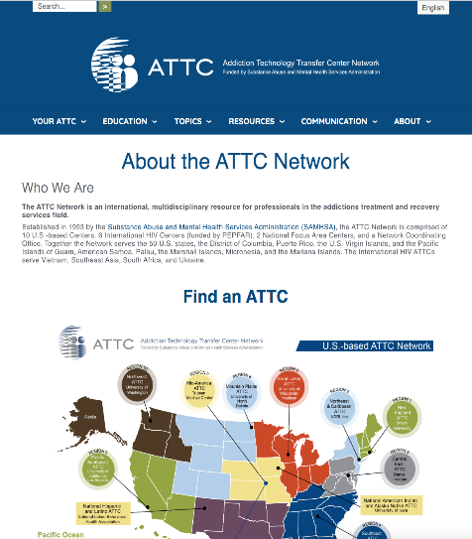
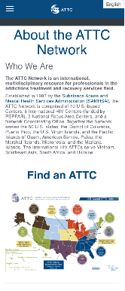

Slide 43
Stay Connected!
Contact us: newenglandattc@brown.edu
Follow Us on Social:
@BrownCAAS on
@ATTCNewEngland on
Website (meet our team, get products, view popular topics):
https://attcnetwork.org/centers/new-england-attc/home https://opioidresponsenetwork.org/SubmitTARequest.aspx
Notes:
I’ll soon be turning it over to [whomever goes next]. These slides will be shared with you. We hope you will stay connected with us by following us on social media, emailing us if you are interested in customized training or TA, and accessing free resources on our website. For the remainder of the LDP, you will also be in incredibly capable hands with our long-term partner of 29 years, Denise Adams, and our prized team member, Ray Sanchez who really deserves the credit on the New England ATTC side for bringing this program to fruition.
Please don’t hesitate to reach out if you have any questions or if we can be of service!

